Slide 1

Po Leung Kuk Ngan Po Ling College IB Information Night

Slide 2
Rundown 流程
1. Vision and Mission / 願景及使命
2. Features of IB Learning / IB學習的特色
3. IB Curriculum at NPLC /顏寶鈴書院的IB課程
4. IB Life in NPLC / 顏寶鈴書院的IB生活
5. School Policies / 學校政策
6. Important Dates / 重要日期

Slide 3
Vision and Mission
願景及使命
Grooming all-rounders to meet 21st century challenges
培育全才迎接21世紀的挑戰
~ Cultivate 21st century skills 培養21世紀的技能
e.g. critical thinking, problem-solving,
communication, collaborative skills
如: 批判性思考、解難能力、溝通技巧、協作能力
~ Develop international-mindedness 發展國際視野

Slide 4
Vision and Mission
願景及使命
Opening up more career pathways to both local and renowned universities overseas
開拓更多於本地及海外知名大學升學的途徑

Slide 5
Features of IB Learning
IB學習的特色
1. Cultivating knowledgeable learners
培育學識淵博的學生
Broad knowledge base
廣闊的知識基礎
Student-centered and interactive learning
學生為本及互動學習
Self-directed and inquiry-based learning
自主探究學習

Slide 6
Features of IB Learning
IB學習的特色
2. Developing lifelong skills 發展終身技能
Nurture communication, creativity and critical thinking skills
培養溝通技能、創意和批判性思維
Train application and problem-solving skills
訓練應用和解難能力
Enhance collaborative skills
提升協作能力

Slide 7

Features of IB Learning
IB學習的特色
3. Enhancing international-mindedness
拓闊國際視野
4. Emphasising balanced personal development
重視個人均衡發展

Slide 8
Features of IB Learning
IB學習的特色
5. Emphasizing Internal assessments重視校內評估
Non-Exam Components Proportion 非考試項目比例
Subject 科目 | IB
Languages 語文 | 25-30%
Individual & Societies 個人與社會 | 20%
Experimental Sciences 實驗科學 | 20%
Mathematics 數學 | 20%
Visual Arts 視覺藝術 | 100%

Slide 9
Advantages of the IBDP
IBDP的優點
Direct application for university programmes
可直接申請大學課程
Early conditional offers from universities
可提早獲大學有條件錄取
Universities award credit and course exemptions
大學學分及課程豁免

Slide 10
IB Curriculum at NPL 顏寶鈴書院的IB課程

Slide 11
Class Structure 班級架構
1 - 2 classes
1 - 2班
max. 29 students per class,
max. 50 students in total per level
一班最多29個學生，一級最多總共50個
學生

Slide 12
Courses Offered in NPLC
Group 1 (First Language)
English, Chinese
Group 2 (Second Language
Chinese / English / French
Group 3
Geography, Economics
Core
Theory of Knowledge
Extended Essay
Creativity, Activity and Service
Group 5
Mathematics: Analysis and Approaches /
Mathematics: Applications and Interpretation
Group 4
Physics, Chemistry, Biology
Group 6
Visual Arts

Slide 13
顏寶鈴書院開設的科目
組別一 (第一語言)
英文,中文
組別二
(第二語言)
中文 /
英文 /
法文
組別三
地理,
經濟
核心課程
知識論
拓展論文
創意、活動與服務
組別五
數學: 分析與方法 /
數學: 應用與理解
組別四
物理,
化學,
生物
組別六
視覺藝術

Slide 14
Curriculum Framework
課程架構
One subject from each group 每個組別選一科
Exception 例外:
1) Replace VA (Gp 6) with a Gp 3 or Gp 4 subject
從組別三或組別四再選一科代替視覺藝術
2) Replace Gp 2 language with another Gp 1
language
以另一組別一語言代替組別二語言

Slide 15
Curriculum Framework
課程架構
6 subjects : 3 Higher Level (HL) and 3 Standard Level (SL)
6 個科目: 3個高級課程(HL)及3個普通課程(SL)
HL: more curriculum time, greater coverage, more demanding in assessment requirement
高級課程: 課時較長、範圍較闊、評核要求較高

Slide 16
Subject Streams in 25/26
 | Science | Engineering | Arts | Business / Social Science
HL | Econ | Math | VA | Econ
 | Chem | Chem / Geo | Chem / Geo / Econ | Geo
 | Bio / Phy | Phy | Bio / Phy | Bio / Phy
SL | Chi / Fr | Chi / Fr | Chi / Fr | Chi / Fr
 | Eng | Eng | Eng | Eng
 | Math | Econ | Math | Math
There is no distinction of Higher Level or Standard Level in the BYP.
All subjects are given roughly the same amount of curriculum time.

Slide 17
25/26年度科目組合
 | 理科 | 工程 | 藝術 | 商科 / 社會科學
HL 高級課程 | 經濟 | 數學 | 視覺藝術 | 經濟
 | 化學 | 化學 | 經濟 /地理 / 化學 | 地理
 | 生物 / 物理 | 物理 | 生物 / 物理 | 生物 / 物理
SL 普通課程 | 中文 / 法文 | 中文 / 法文 | 中文 / 法文 | 中文 / 法文
 | 英文 | 英文 | 英文 | 英文
 | 數學 | 經濟 | 數學 | 數學
銜接課程不分HL或SL。 所有科目課時基本相同。

Slide 18
Curriculum Framework
課程架構
IB Core / IB 核心課程 :
1) Theory of Knowledge (TOK) 知識論
~ study on how knowledge is formed
研究知識如何建構
2) Extended Essay (EE) 拓展論文
~ individual academic research (4000 words)
個人的學術研究 (4000字)
3) Creativity, Activity, Service (CAS) 創意、活動與服務
~ long-term services and activities engagement
長期參與的服務及活動

Slide 19
Curriculum Framework
課程架構
BYP (F4) / 銜接課程(中四) :
6 academic subjects + Core (foundation skills
course) + Citizenship & Social Development
六個學術科目 + 核心課程 (基礎技能課程) + 公民及社會
發展科
Year 1 (F5) & Year 2 (F6) / 中五及中六
6 academic subjects + TOK + EE + CAS
六個學術科目 + 知識論 + 拓展論文 + 創意、活動與服務

Slide 20
IB Scoring System
IB計分方式
Highest score for each subject is 7 points
每科最高7分
TOK and the EE contribute up to 3 points
TOK及EE合計最高3分
Fulfill CAS requirements (Pass / Fail)
完成CAS要求 (合格/不合格)
Maximum total score = 45
最高分= 45
Must Pass in TOK, EE, CAS to attain the IB Diploma
要取得IB文憑，TOK、EE、CAS必須合格

Slide 21
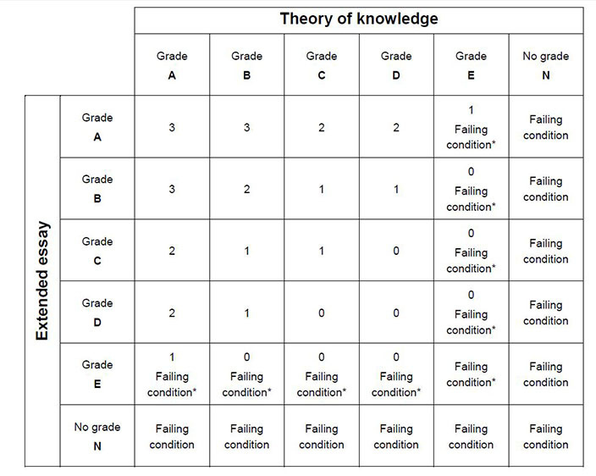
IB Scoring System
IB計分方式
EE & TOK Matrix
EE及TOK
分數組合

Slide 22
IB Life in NPLC
顏寶鈴書院的IB生活

Slide 23
Strengths of NPLC
顏寶鈴書院的優勢
Academic excellence 卓越成績
World average 2025 全球平均 | NPLC average 2025 顏寶鈴書院平均
81.9% pass the diploma programme 81.9% 取得文憑 57.8% get more than 30 points 57.8% 取得30分以上 Average: 30.6/45 平均分: 30.6/45 9.8% of them get 40 points and above 9.8% 取得40分以上 | 100% pass the diploma programme 100% 取得文憑 100% get more than 30 points 100% 取得30分以上 Average: 39.1/45 平均分: 39.1/45 45.8% of them get 40 points and above 45.8% 取得40分以上 Two of them get 45 points 2位學生取得滿分45分

Slide 24
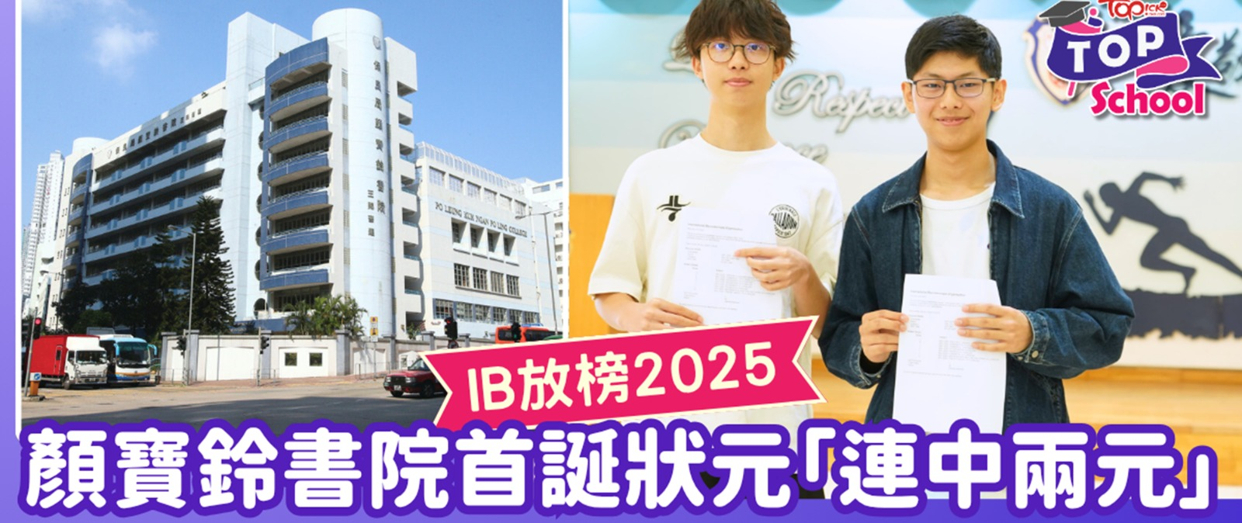
Strengths of NPLC
顏寶鈴書院的優勢
Academic excellence 卓越成績

Slide 25
Strengths of NPLC
顏寶鈴書院的優勢
Rich resources available as a DSS school
直資學校擁有豐富資源
Multicultural learning environment (about 10 – 15% non-Chinese students)
多元文化學習環境 (有約10-15%非華語學生)
Bridging Year Programme in F4 allows smooth transition to IBDP
中四銜接課程讓學生順利過渡至IBDP

Slide 26
Adding Value in
Academic Achievement
為學業成績增值
Academically excellent and professionally trained teachers
師資優秀專業
* All IB teachers completed IB training
所有IB老師均已完成IB的培訓
Qualification 學歷 | Percentage 百分比
PhD 博士 | 5%
Master Degree 碩士 | 53%
Bachelor Degree 學士 | 100%

Slide 27
Adding Value in
Academic Achievement
為學業成績增值
Hardworking and caring team
勤奮及富愛心的團隊
Small class teaching
→ better individual attention
小班教學 → 更能照顧個別學生

Slide 28
Adding Value in
Academic Achievement
為學業成績增值
Differentiated Learning & Teaching
因材施教
~ Core and Extended Curriculum
核心及延伸課程
~ Remedial & Enhancement 拔尖補底
Active Learning Skills 主動學習的技能
Inquiry-based learning 探究式學習

Slide 29
Adding Value in
Academic Achievement
為學業成績增值
Comparison between F3 rank and IB result & destination
F3 Rank | IB Score | University | Programme
12 | 40 | HKU | International Business and Global Management
42 | 37 | HKU | Business Administration (Economics & Finance)
64 | 38 | HKU | Business Administration (Accounting & Finance)
81 | 34 | CUHK | Nursing
109 | 34 | HKUST | Business Administration (Information System)

Slide 30
Adding Value in
Academic Achievement
為學業成績增值
中三排名及IB成績與出路的比較
F3排名 | IB成績 | 大學 | 課程
12 | 40 | 港大 | 國際商業及環球管理
42 | 37 | 港大 | 工商管理 (經濟及金融)
64 | 38 | 港大 | 工商管理 (會計及財務)
81 | 34 | 中大 | 護理學
109 | 34 | 科大 | 工商管理 (資訊系統)

Slide 31
NPLC Graduates
Hong Kong Universities
Admission Highlights
University | Programme
University of Hong Kong | International Business and Global Management
 | MBBS (Medicine)
 | Business Administration (Accounting & Finance)
 | UCL Dual Degree Programme in Law (operated with UCL)
 | Education in Language Education - English (double degree)
Chinese University of Hong Kong | Enrichment Program in Theoretical Physics
 | Pharmacy
 | Nursing
Hong Kong University of Science and Technology (HKUST) | Business Administration (Information Systems)
 | Engineering Programme (with scholarship)
 | Marketing
The Hong Kong Polytechnic University | Occupational Therapy
 | Aviation Engineering

Slide 32
顏寶鈴畢業生本地大學入學情況摘要
大學 | 課程
香港大學 | 國際商業及環球管理
 | 醫學
 | 工商管理 (會計及財務)
 | HKU-UCL雙學位法律課程
 | 英文教育 (雙學位課程)
香港中文大學 | 理論物理精研
 | 藥劑學
 | 護理學
香港科技大學 | 工商管理 (資訊系統)
 | 工學院(連獎學金)
 | 市場學
香港理工大學 | 職業治療
 | 航空工程學

Slide 33
NPLC Graduates
Overseas Admission Highlights
University | Programme
University of Edinburgh, UK | BVM&S (Veterinary Medicine)
University of the Arts London, UK | Design Management
University of Toronto, Canada | Forensic Science
 | Computer Science
University of Sydney, Australia | Medical Science
Monash University, Australia | Occupational Therapy

Slide 34
顏寶鈴畢業生海外大學入學情況摘要
University | Programme
英國愛丁堡大學 | 獸醫
英國倫敦藝術大學 | 設計管理
加拿大多倫多大學 | 法證科學
 | 計算機科學
澳洲悉尼大學 | 醫學
澳洲蒙納士大學 | 物理治療

Slide 35
Adding Value in
Personal Development
為個人成長增值
Enhance international-mindedness and responsible citizenship through:
透過以下活動加強國際視野及公民意識 ：
~ CAS activities
CAS活動
~ Competitions and Symposiums
比賽及研討會
~ Exchange programmes
交流計劃

Slide 36
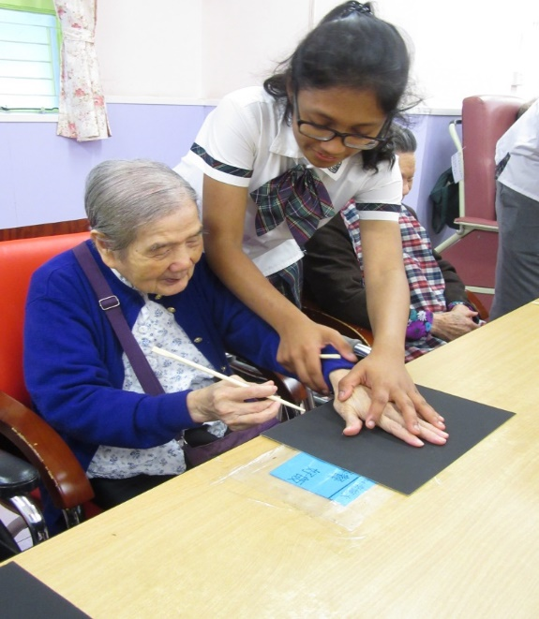
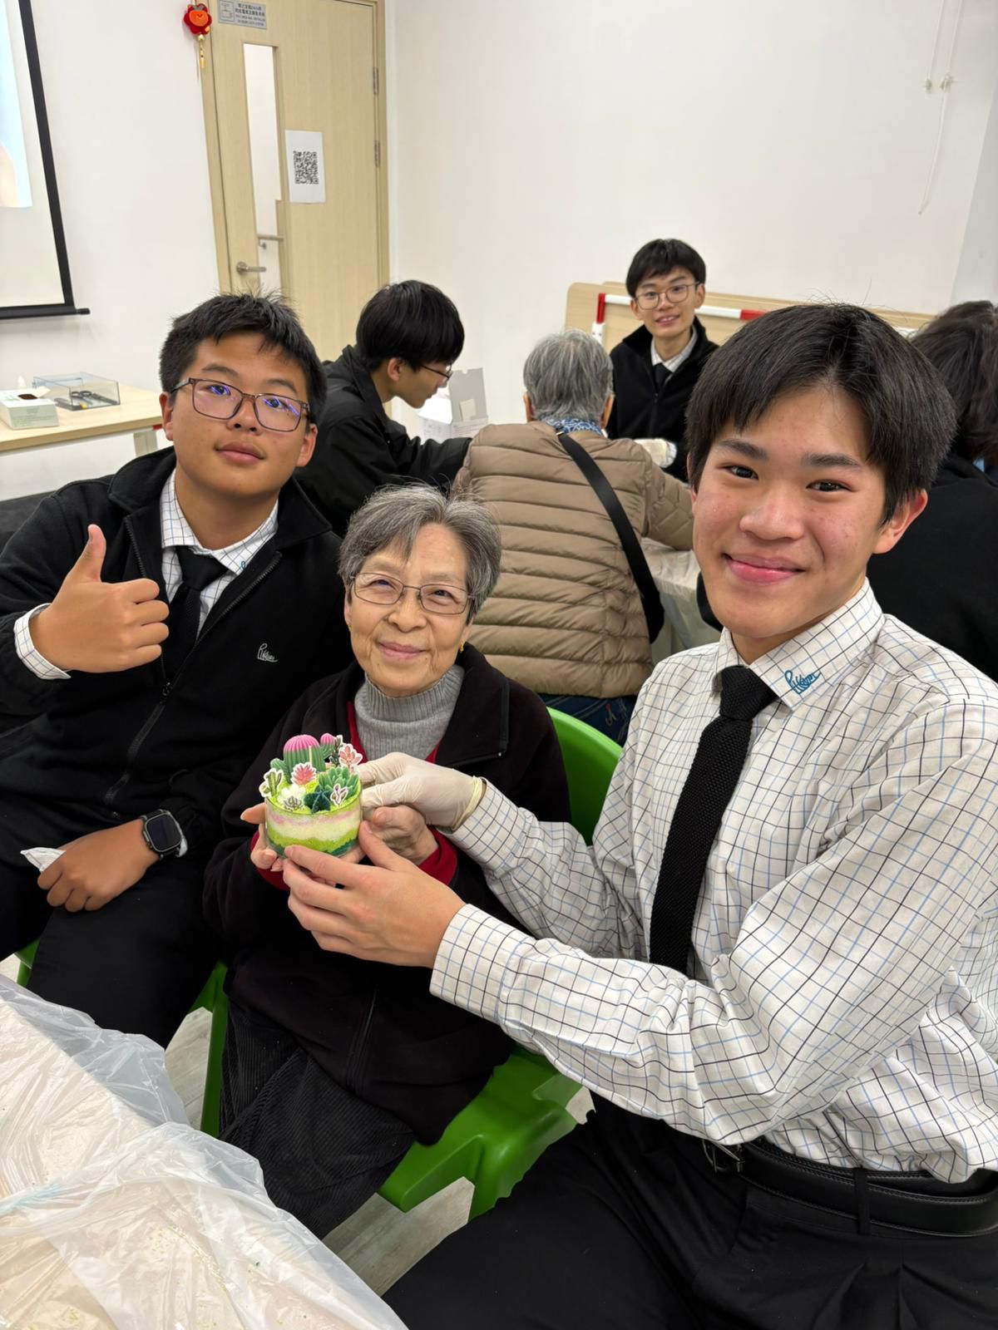
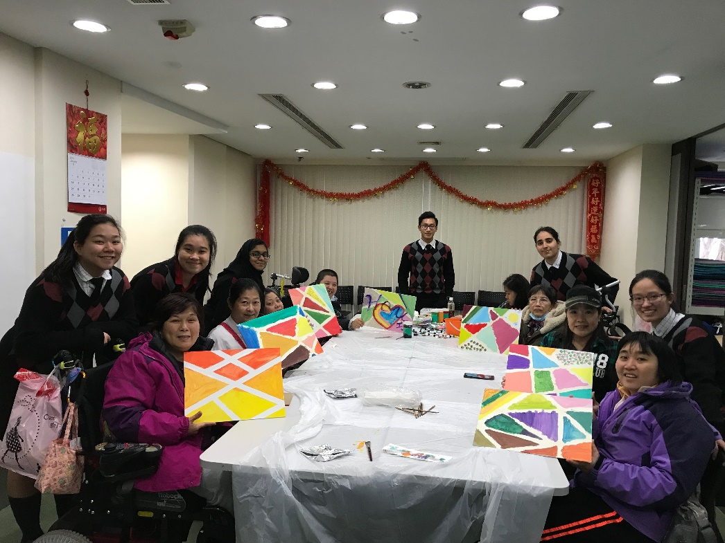
Community Service
社區服務

Slide 37
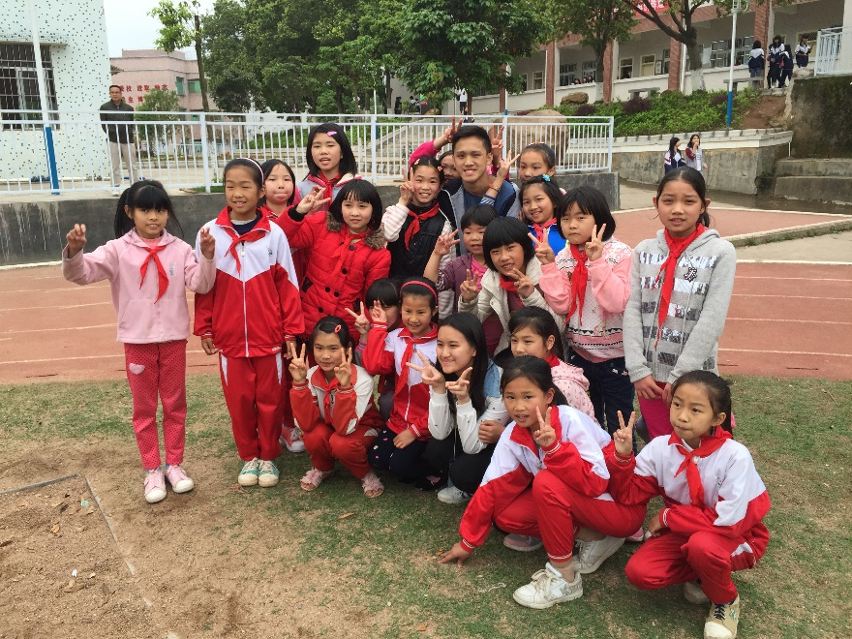
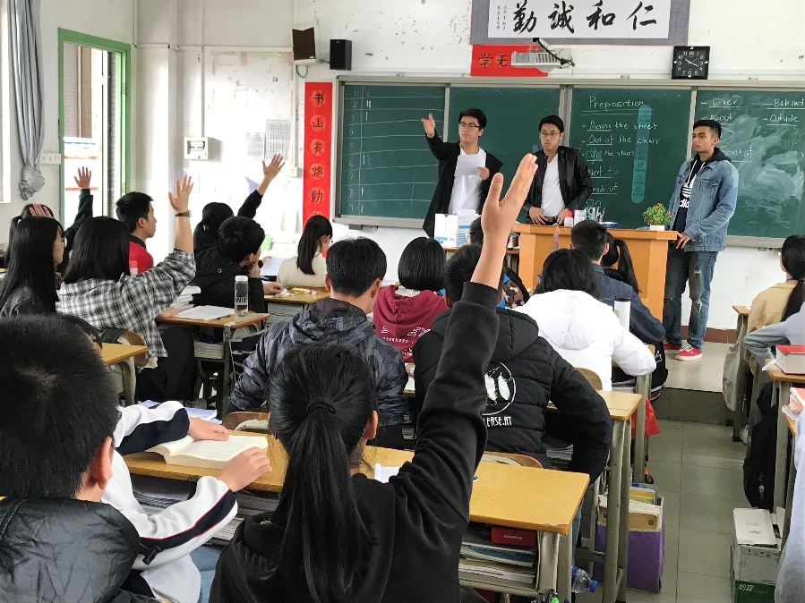
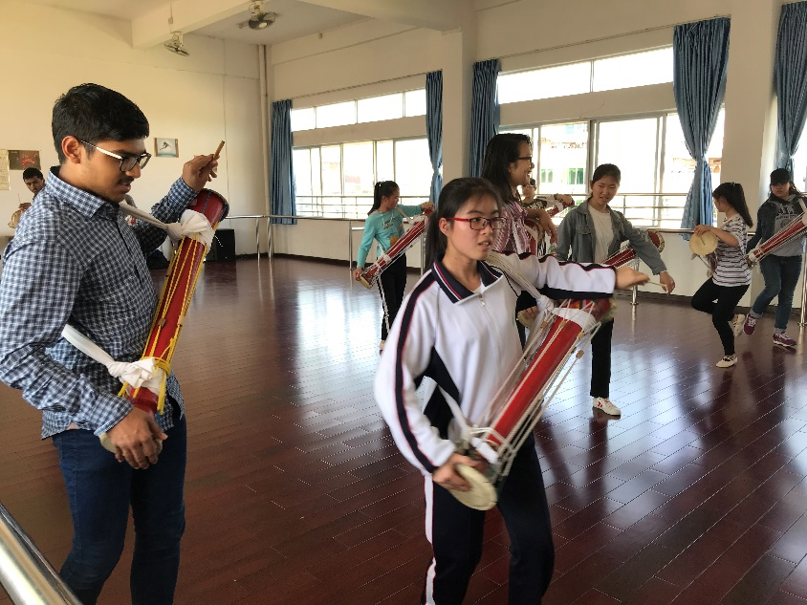
CAS trip: Project Hope in China
CAS義遊團：希望工程
(2016 - 2018)

Slide 38



CAS trip: Northern Thailand (2019)
CAS義遊團：泰北 (2019)

Slide 39


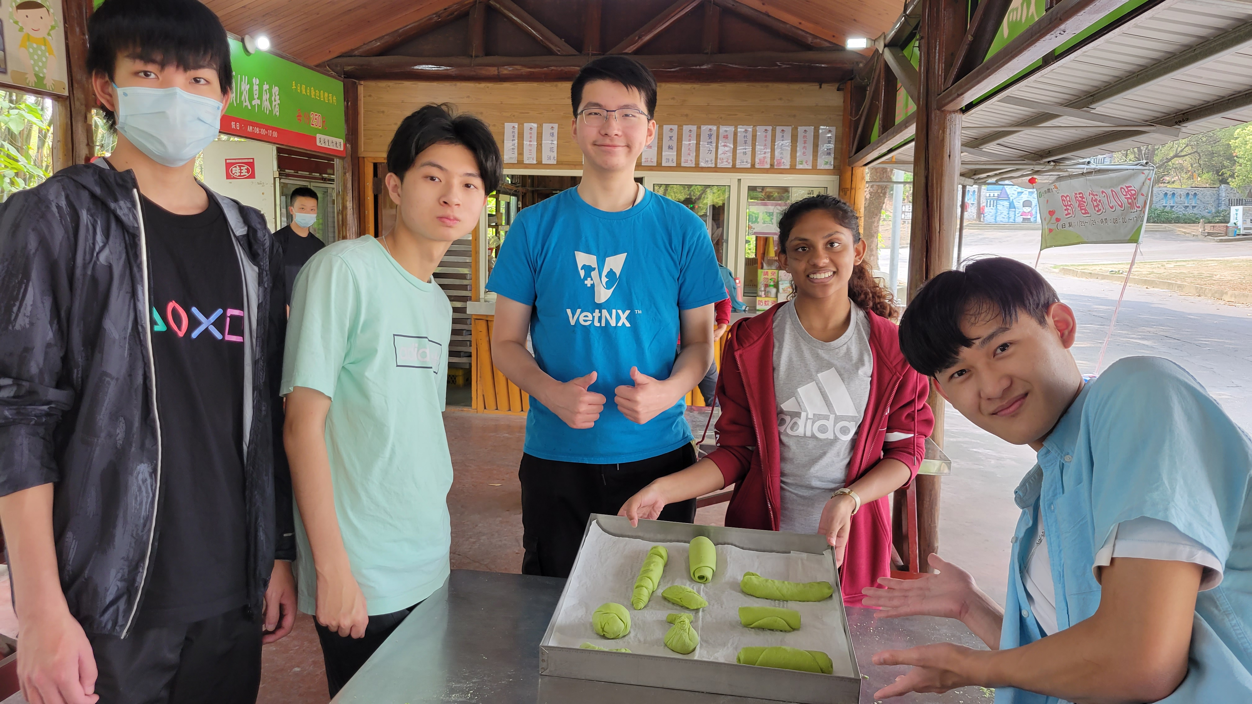
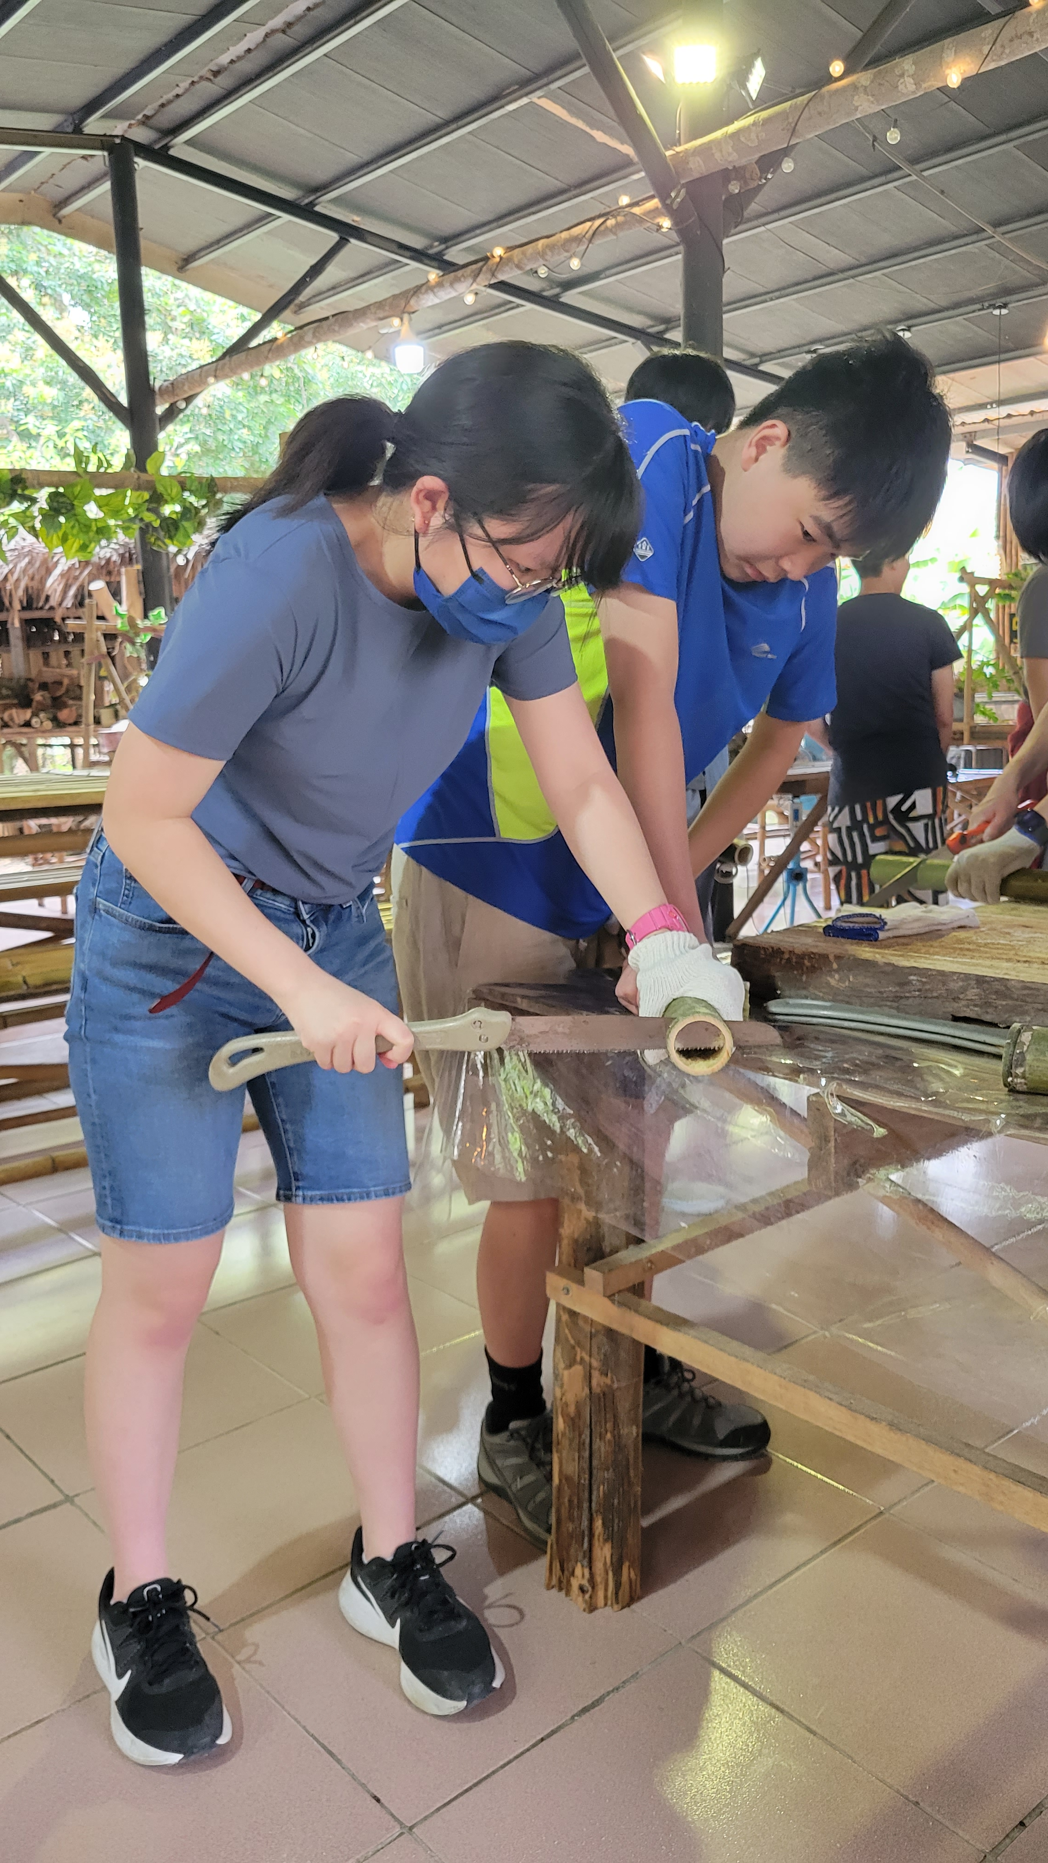

CAS trip: Taiwan (2023)
CAS義遊團：台灣 (2023)

Slide 40
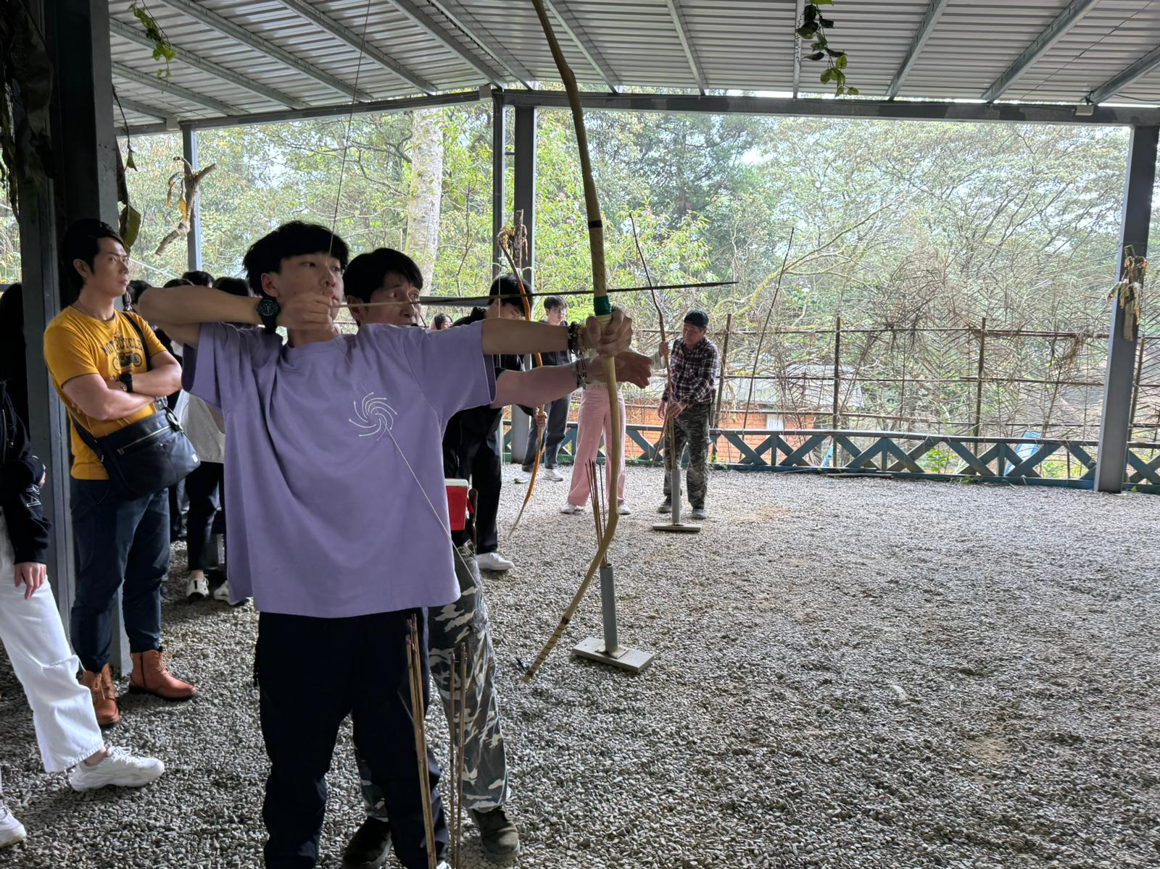

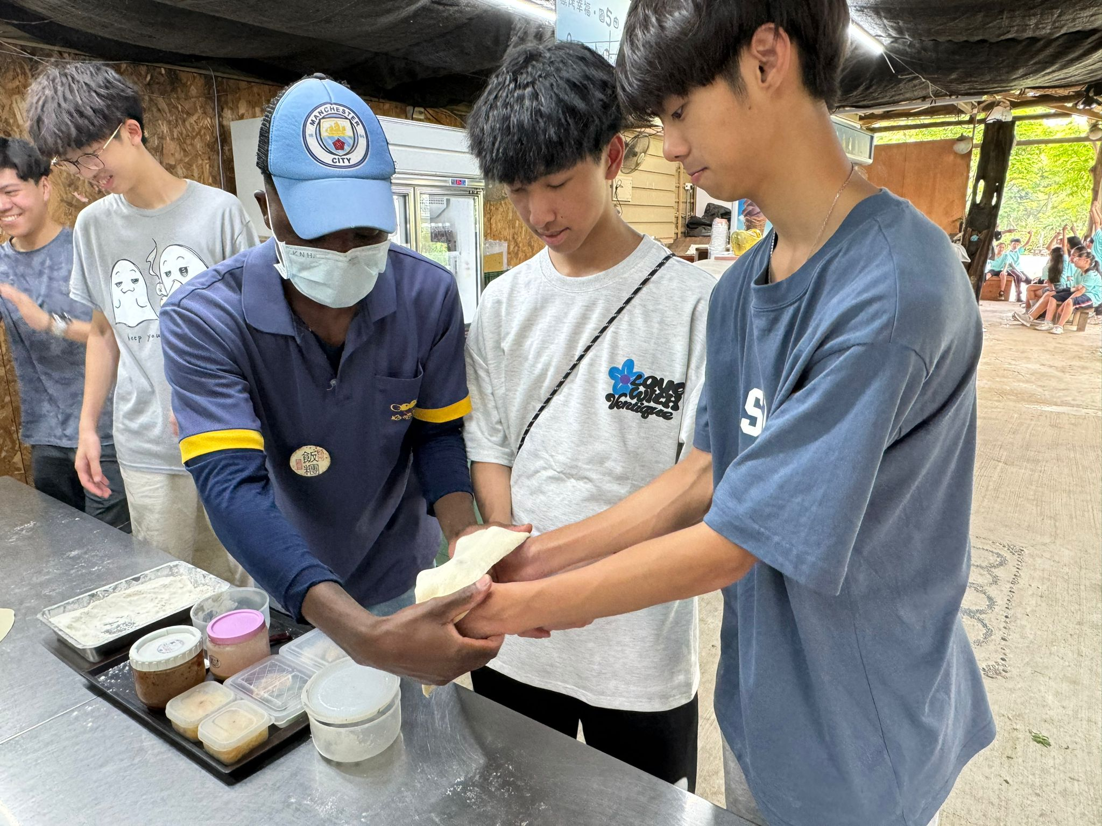
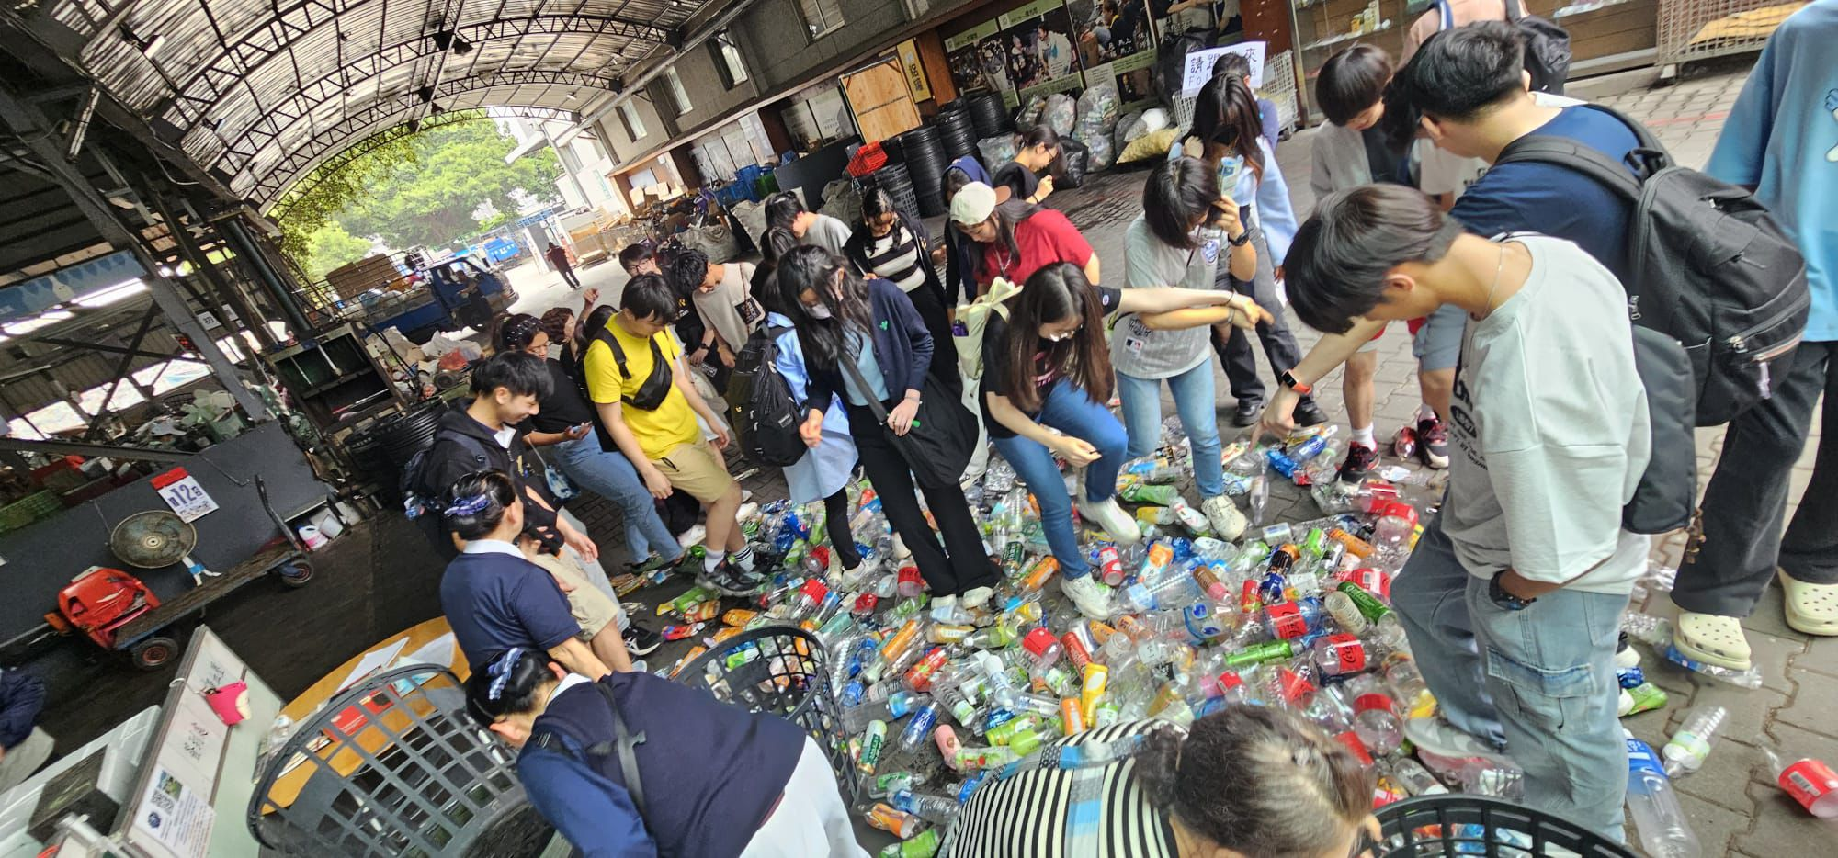
CAS trip: Taiwan (2024)
CAS義遊團：台灣 (2024)

Slide 41
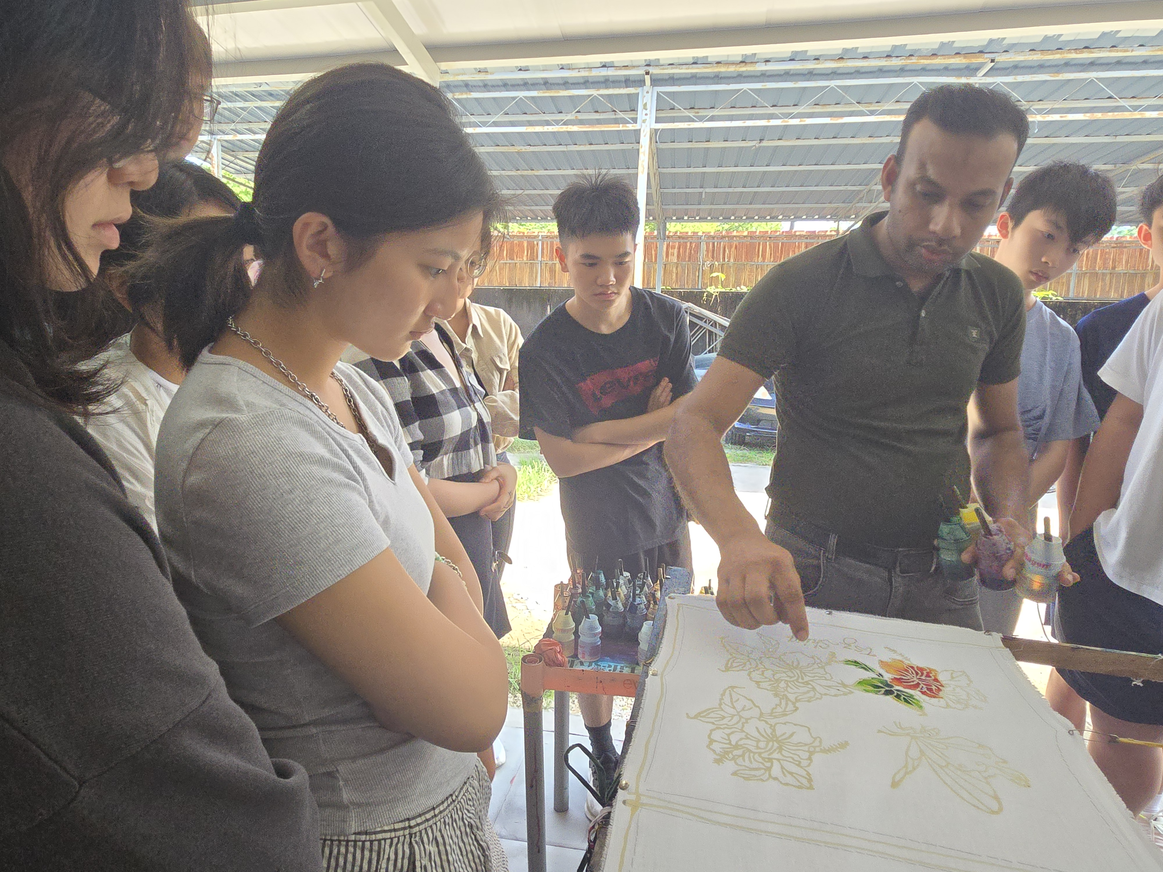
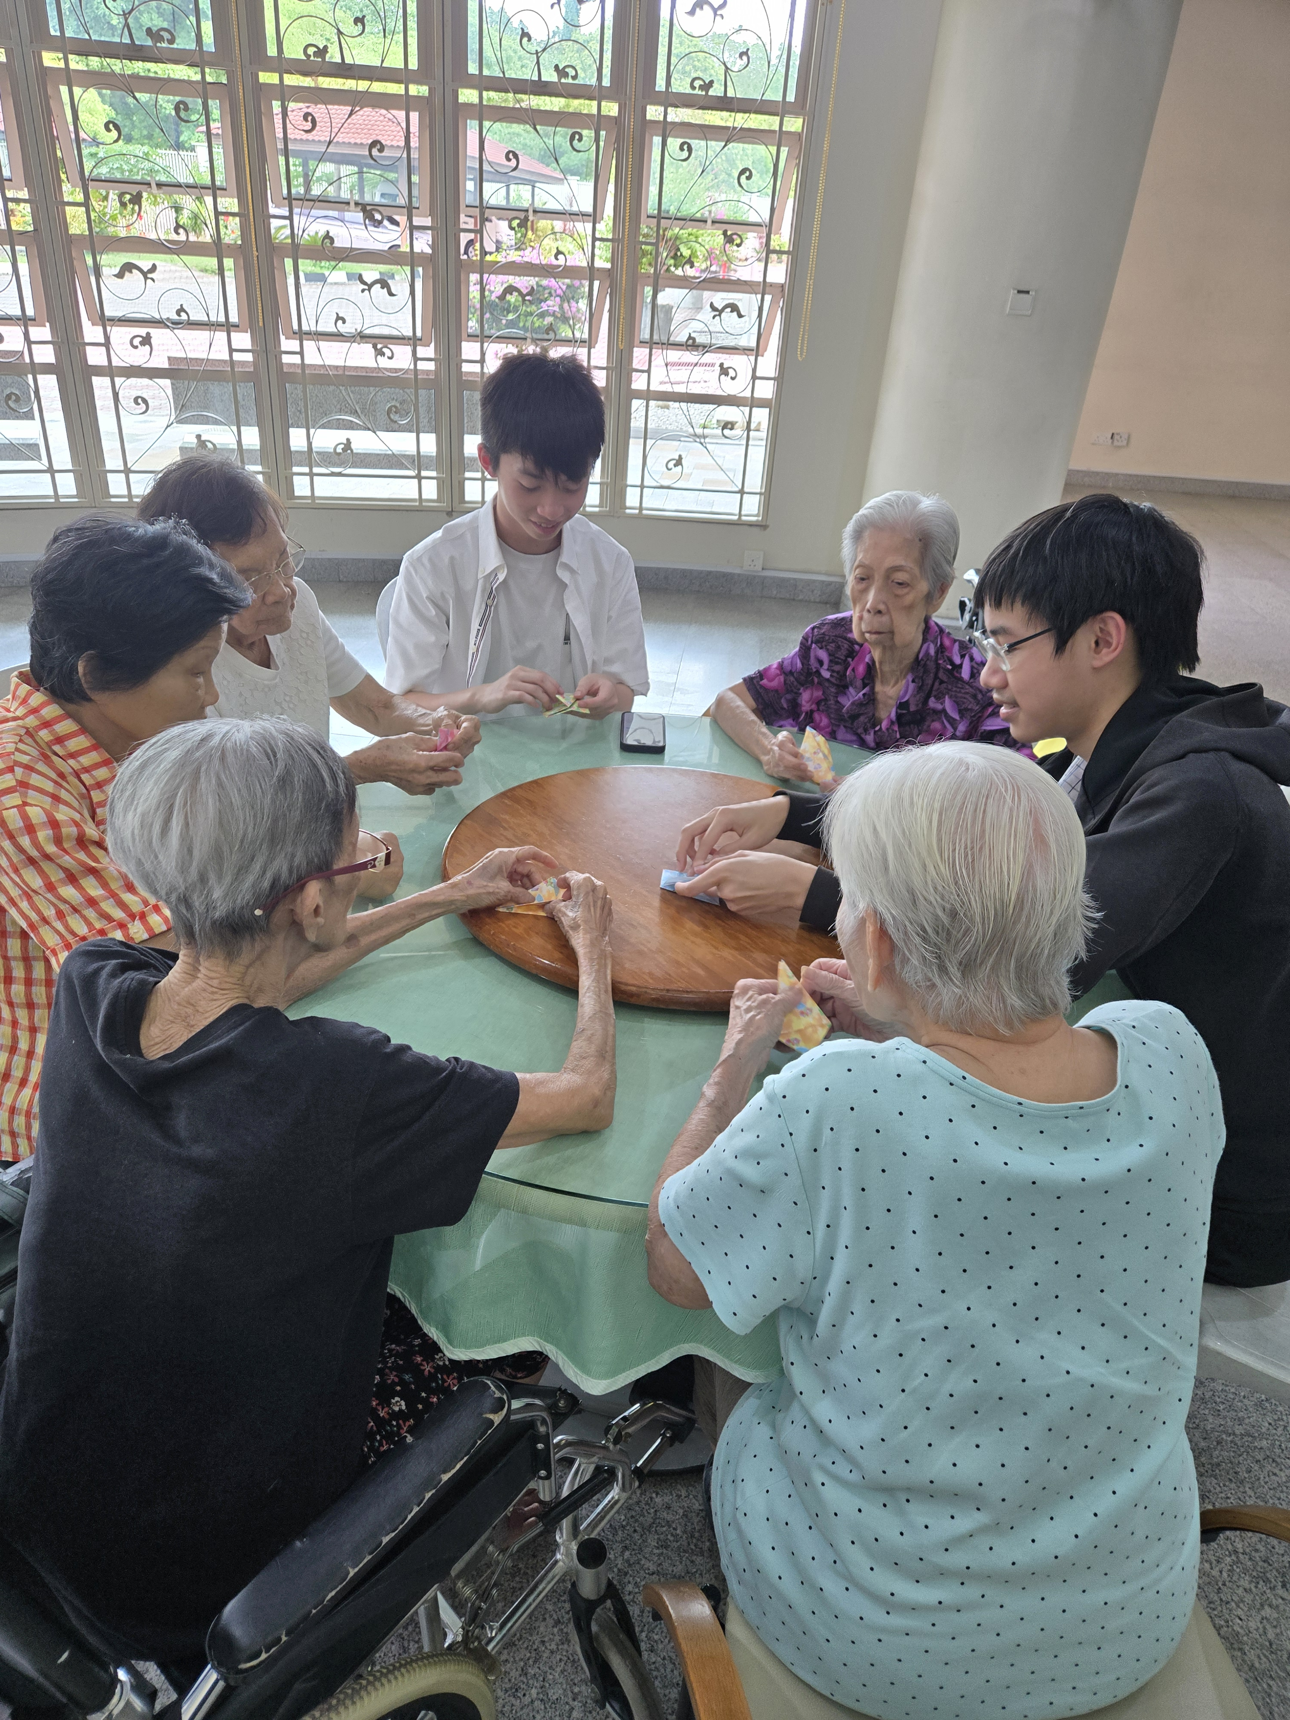
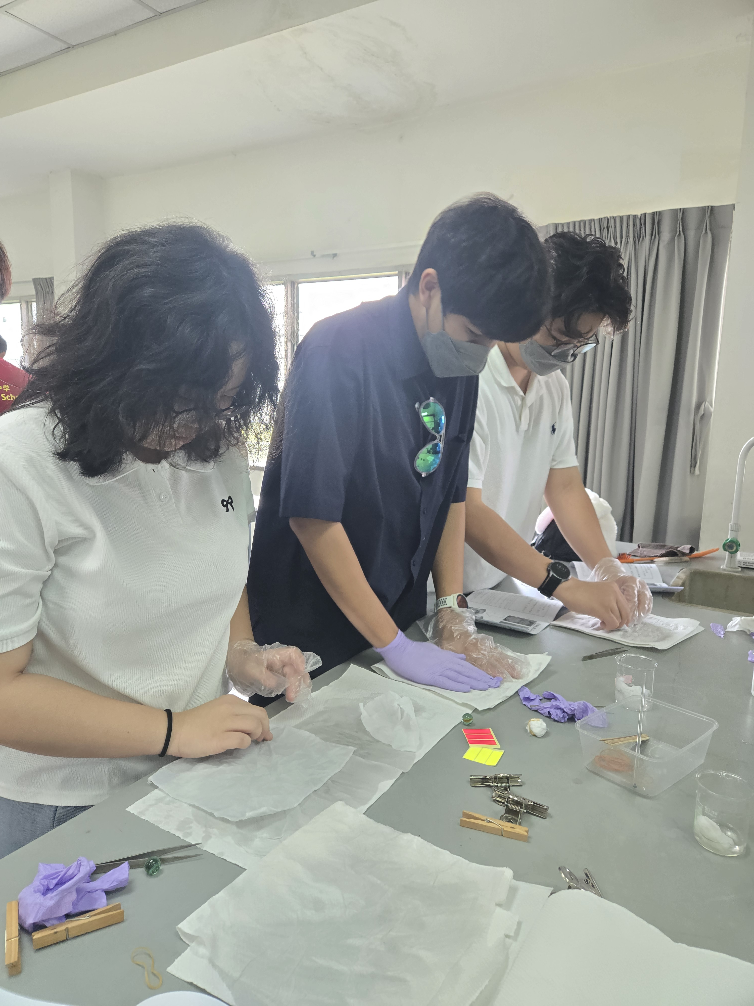
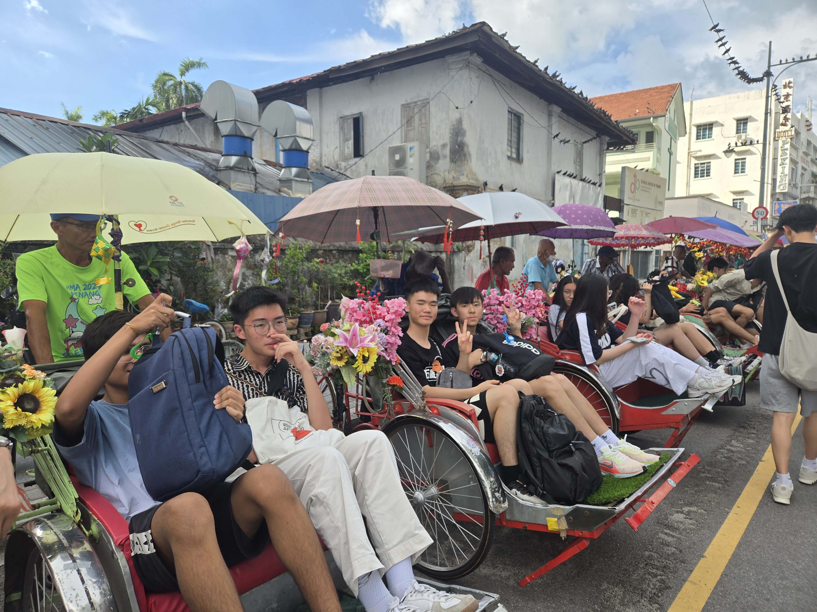

CAS trip: Malaysia (2025)
CAS義遊團：馬來西亞 (2025)

Slide 42
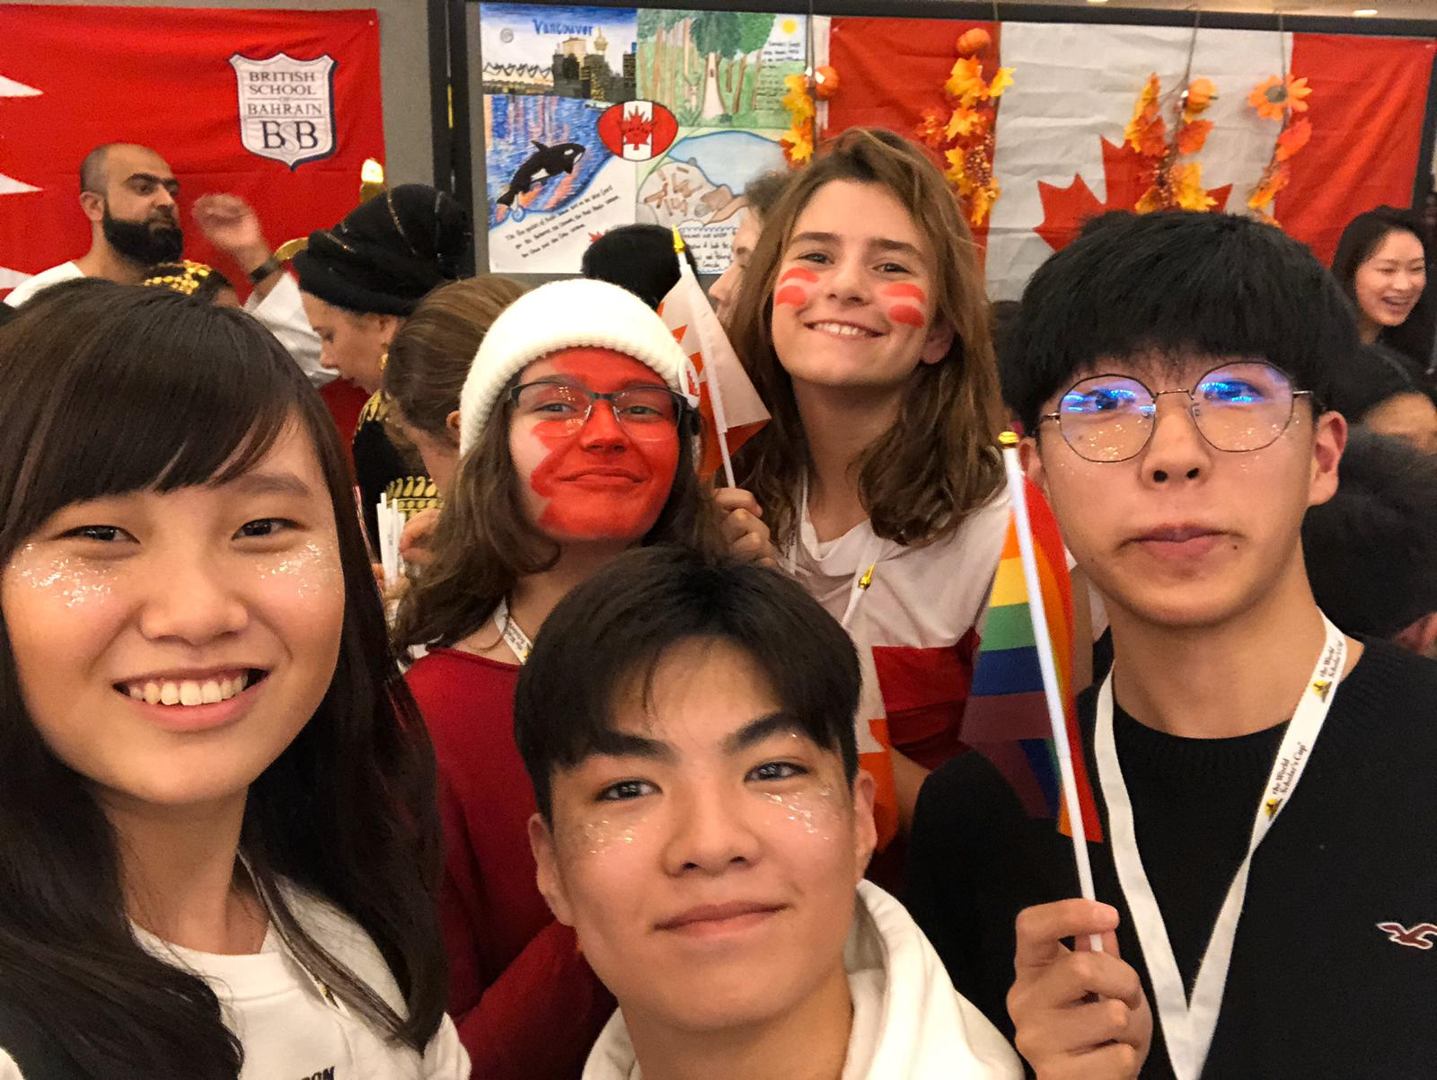
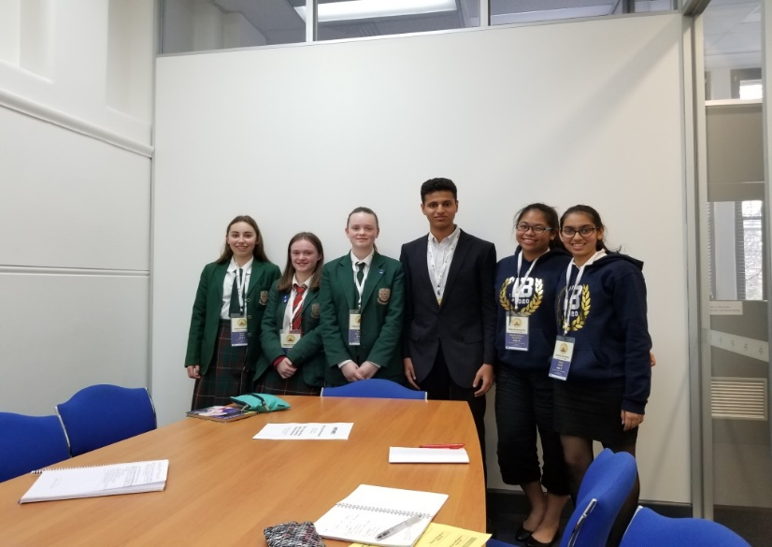


World Scholar’s Cup
世界學者盃

Slide 43
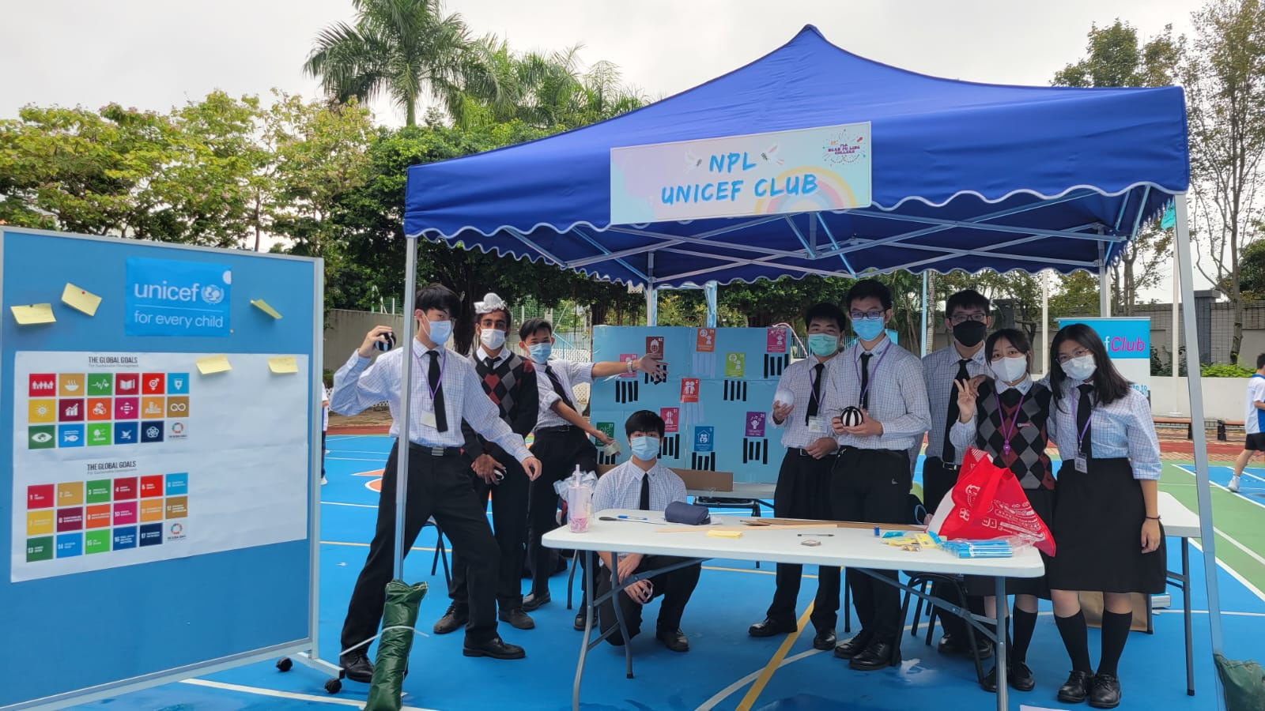
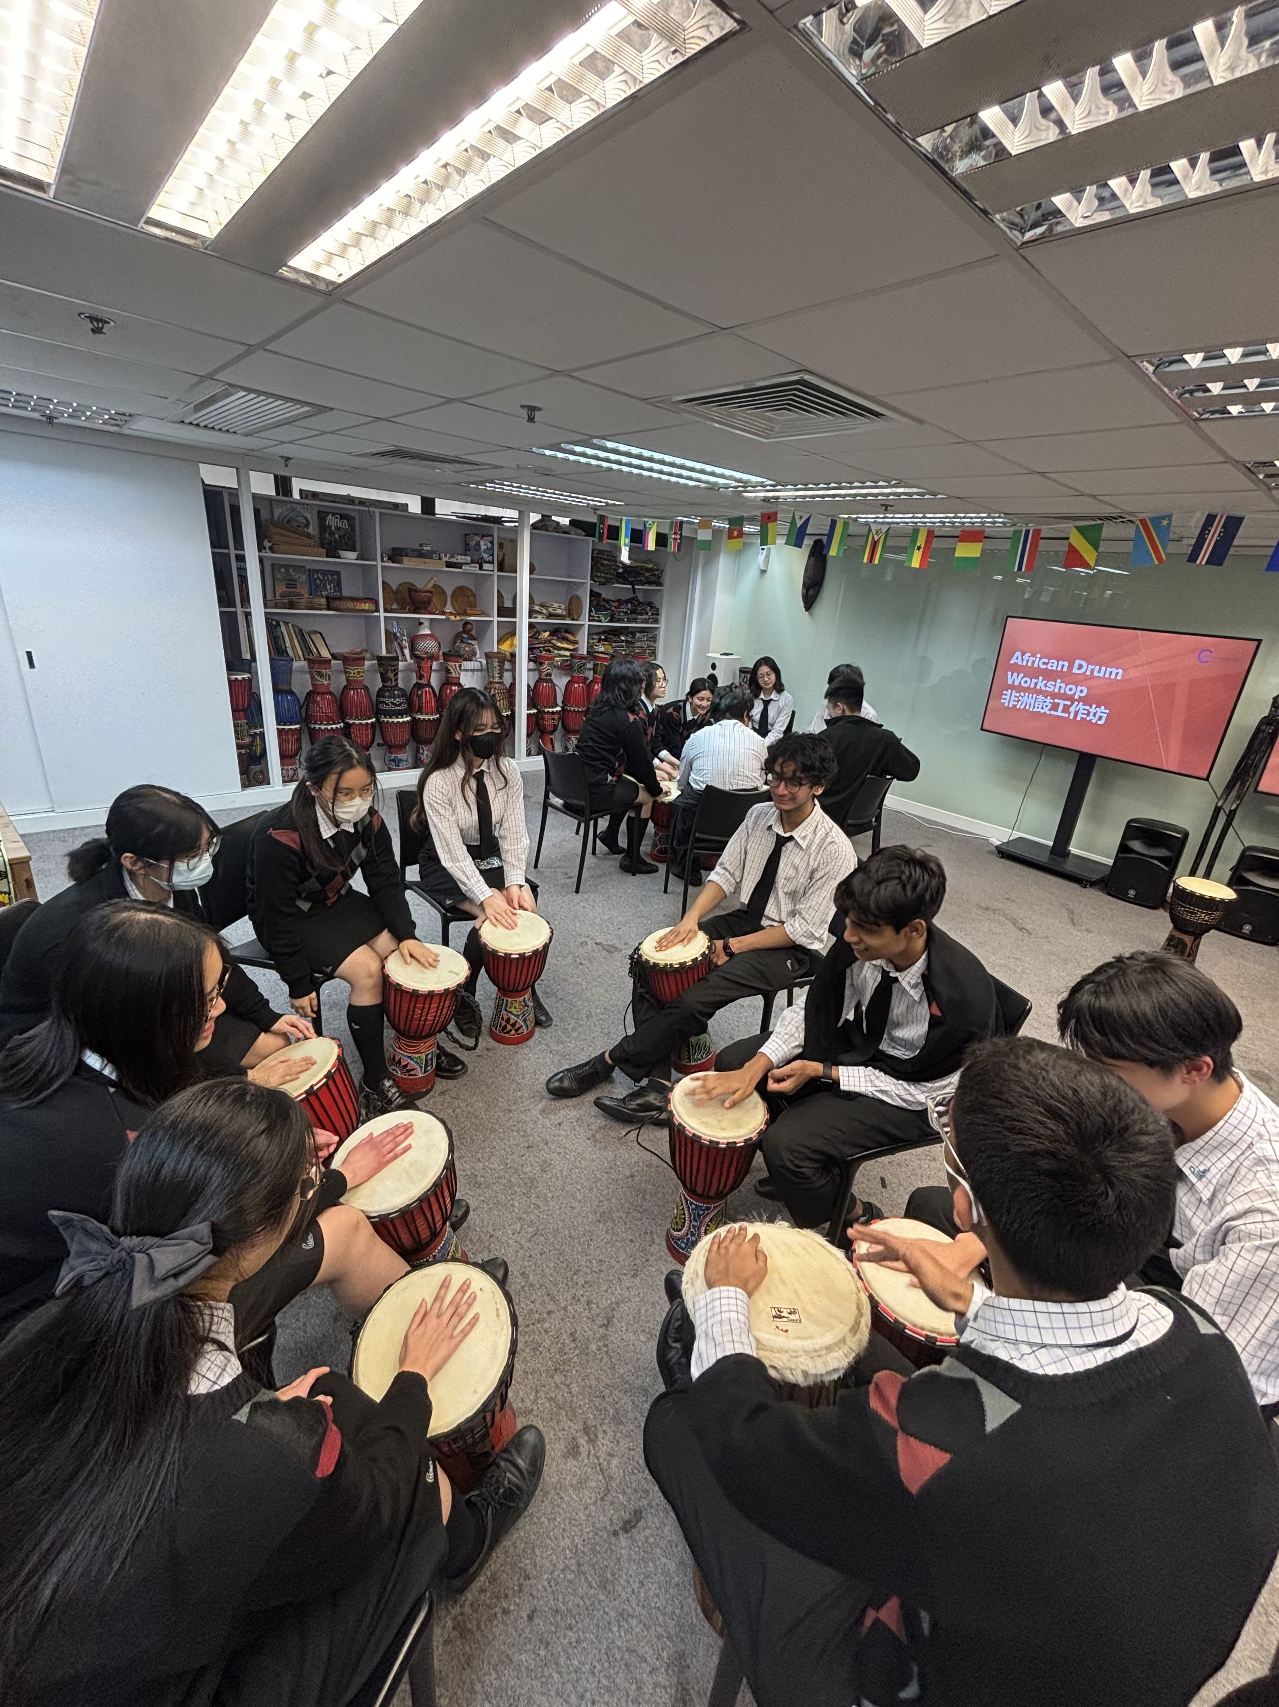

Self-Initiated Activities
學生自發活動
NPL UNICEF Club
顏寶鈴聯合國兒童基金學會
NPL MUN Club
顏寶鈴模擬聯合國學會
Multicultural Club
多元文化學會
Youth Leadership Council
青年領袖學生會
Green Club
環保學會
Volunteer Club
義工服務學會

Slide 44
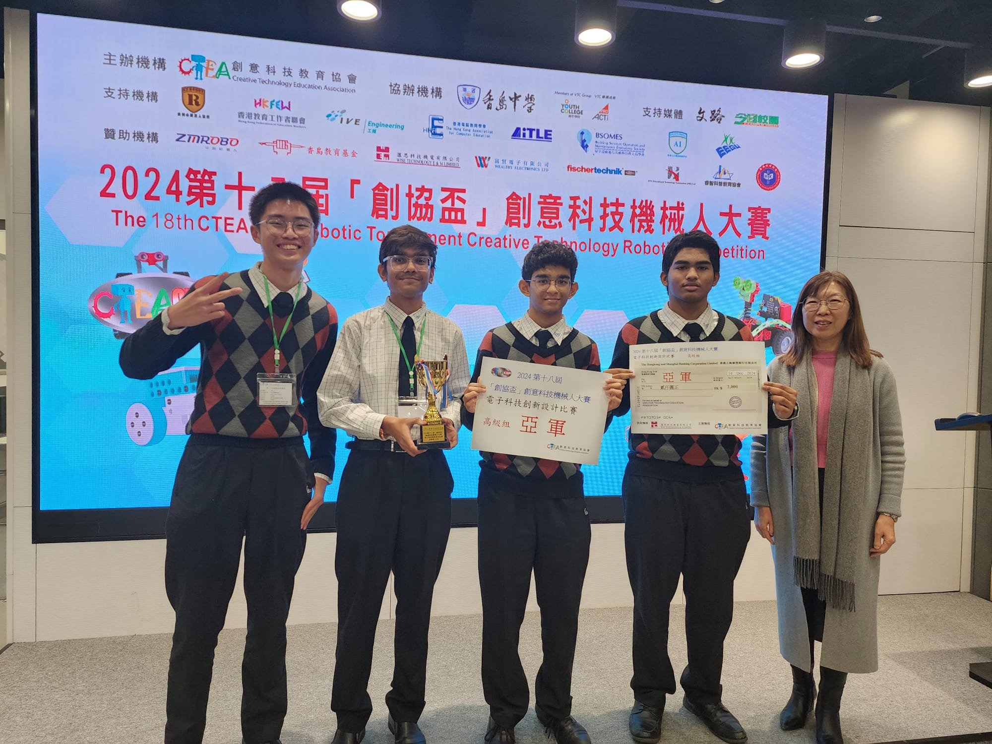
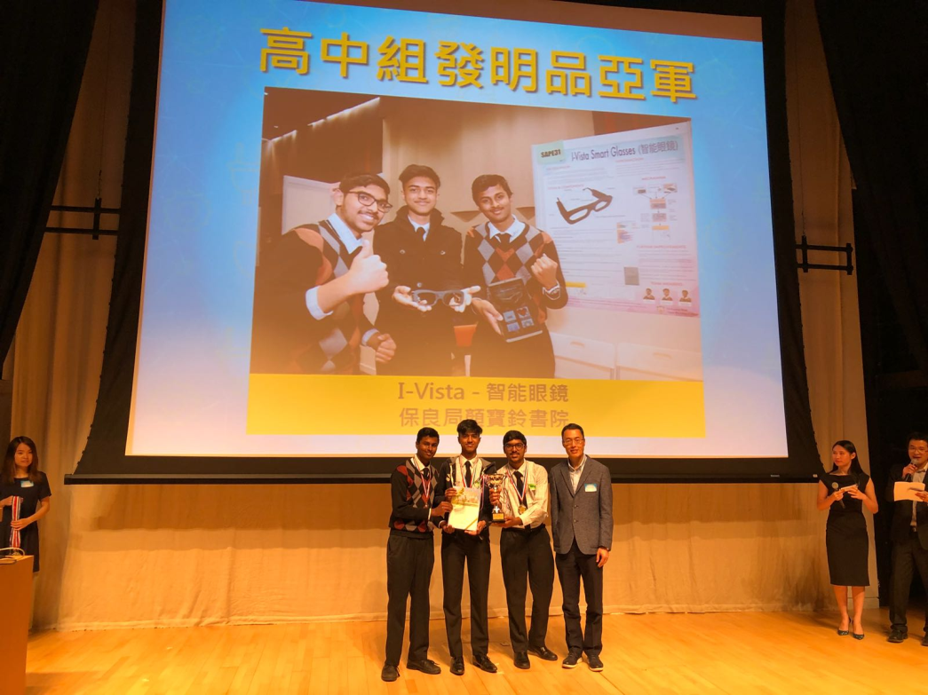
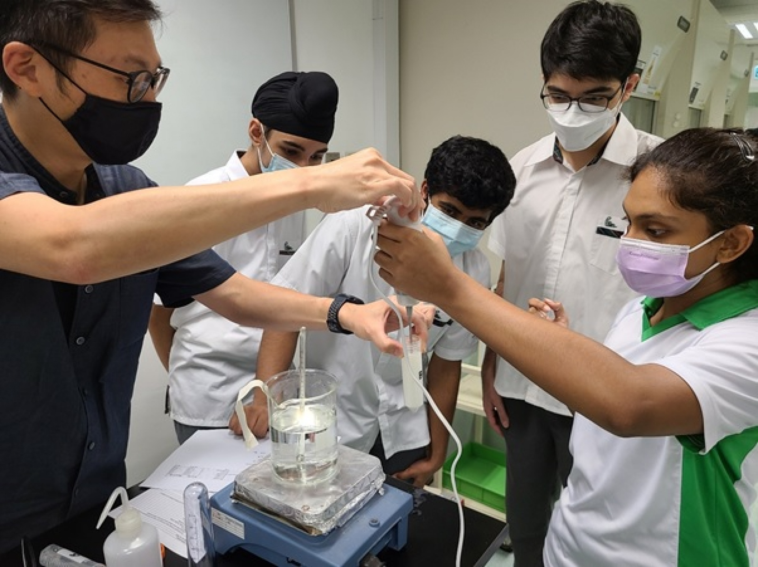
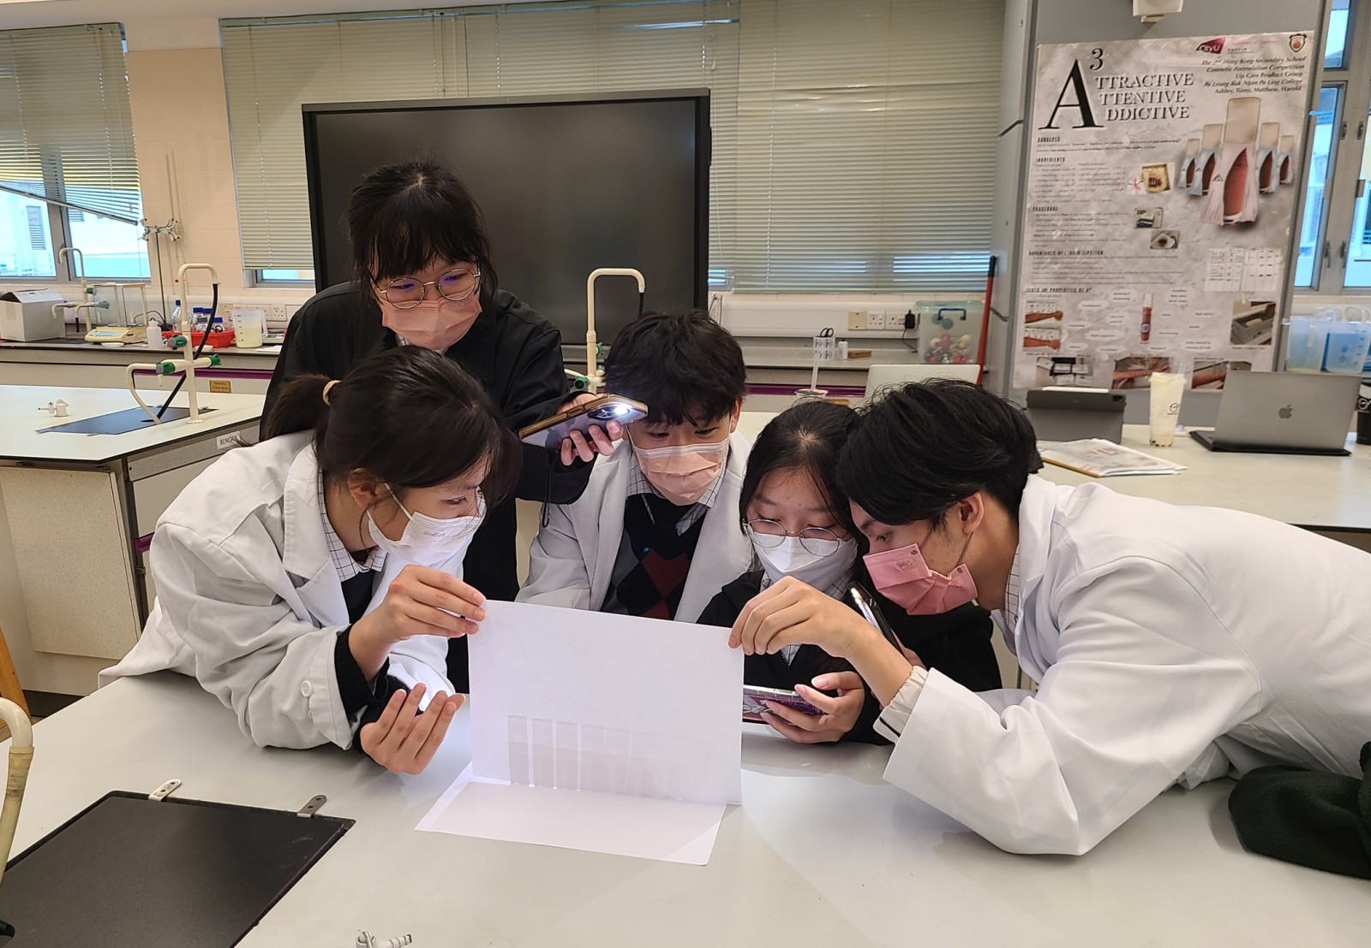
Research Teams & Inventions
研究小組與發明

Slide 45
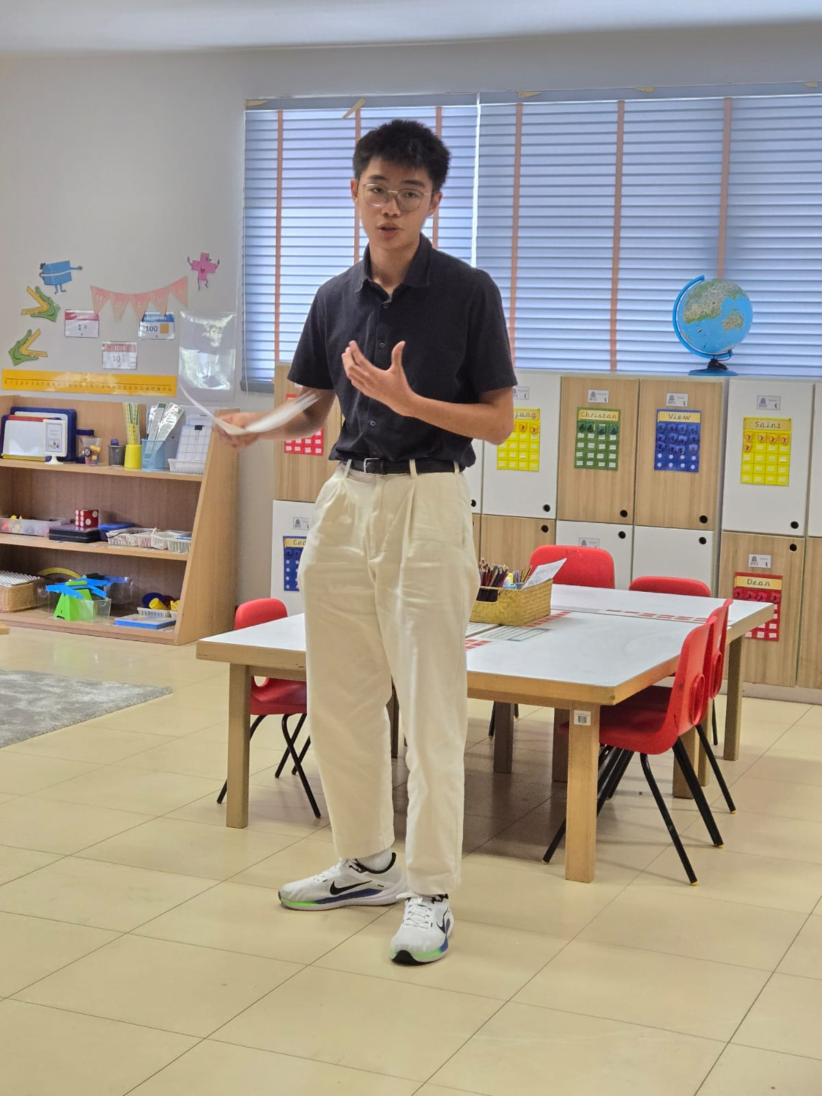
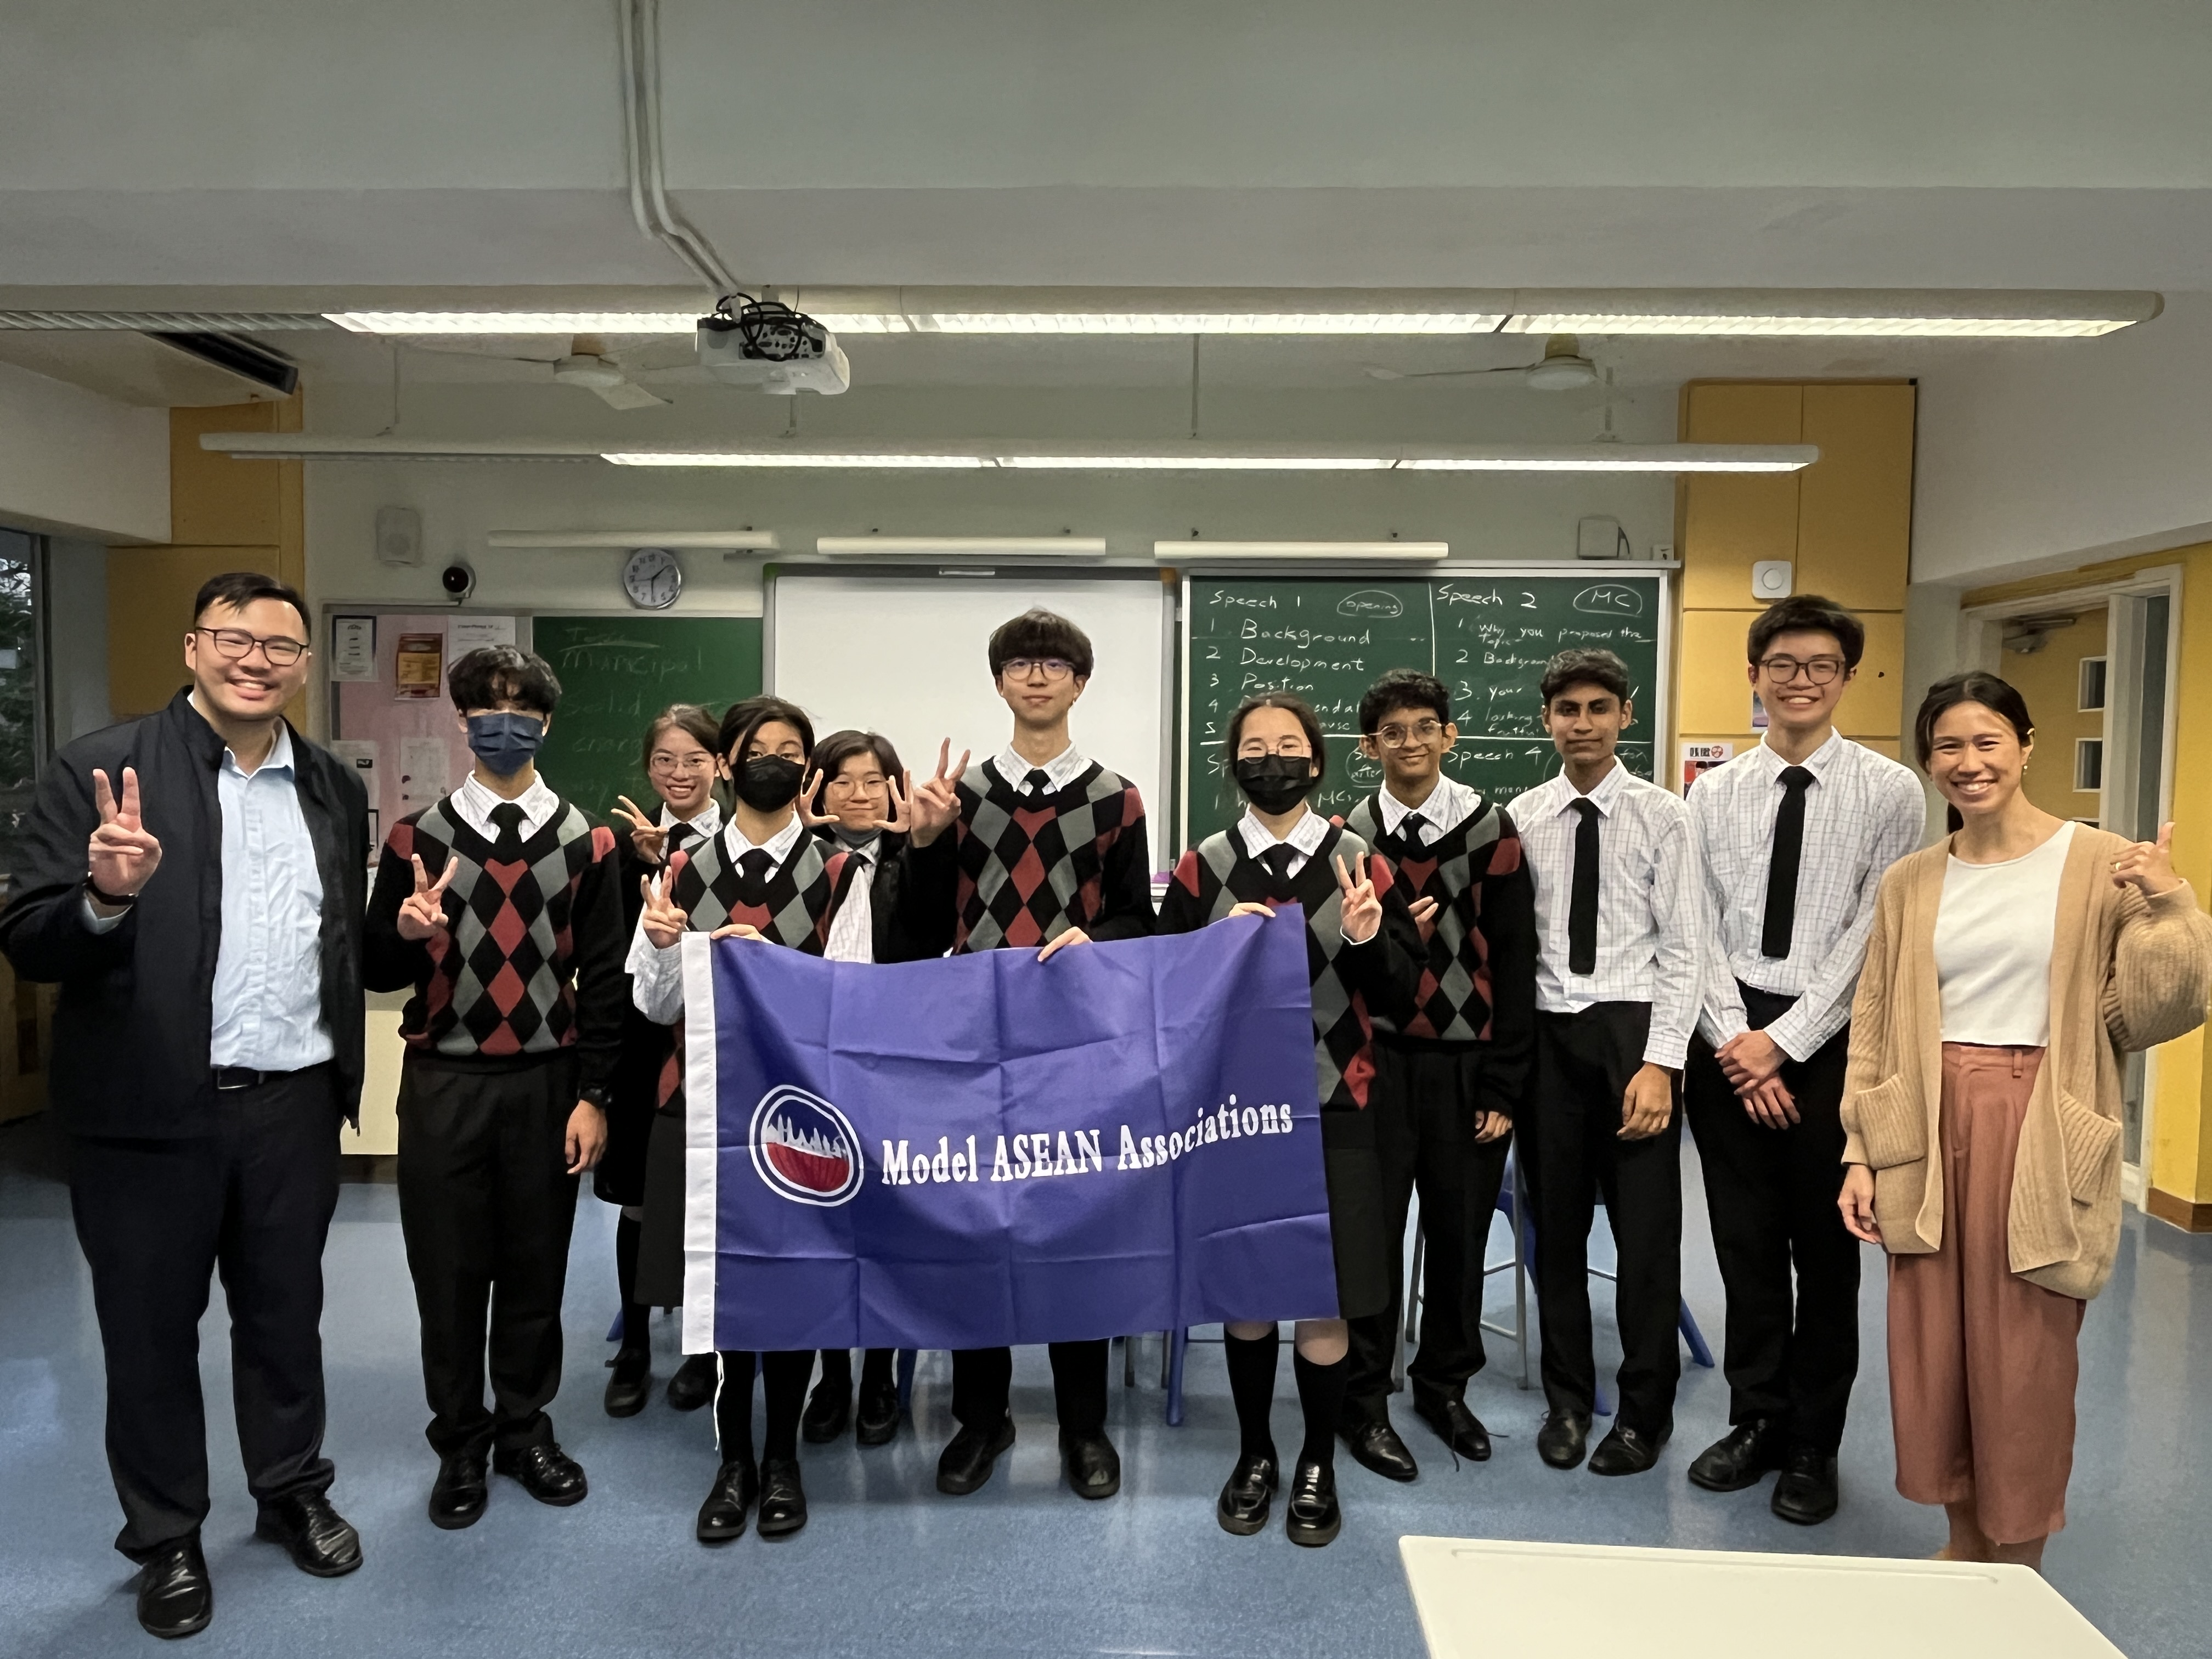

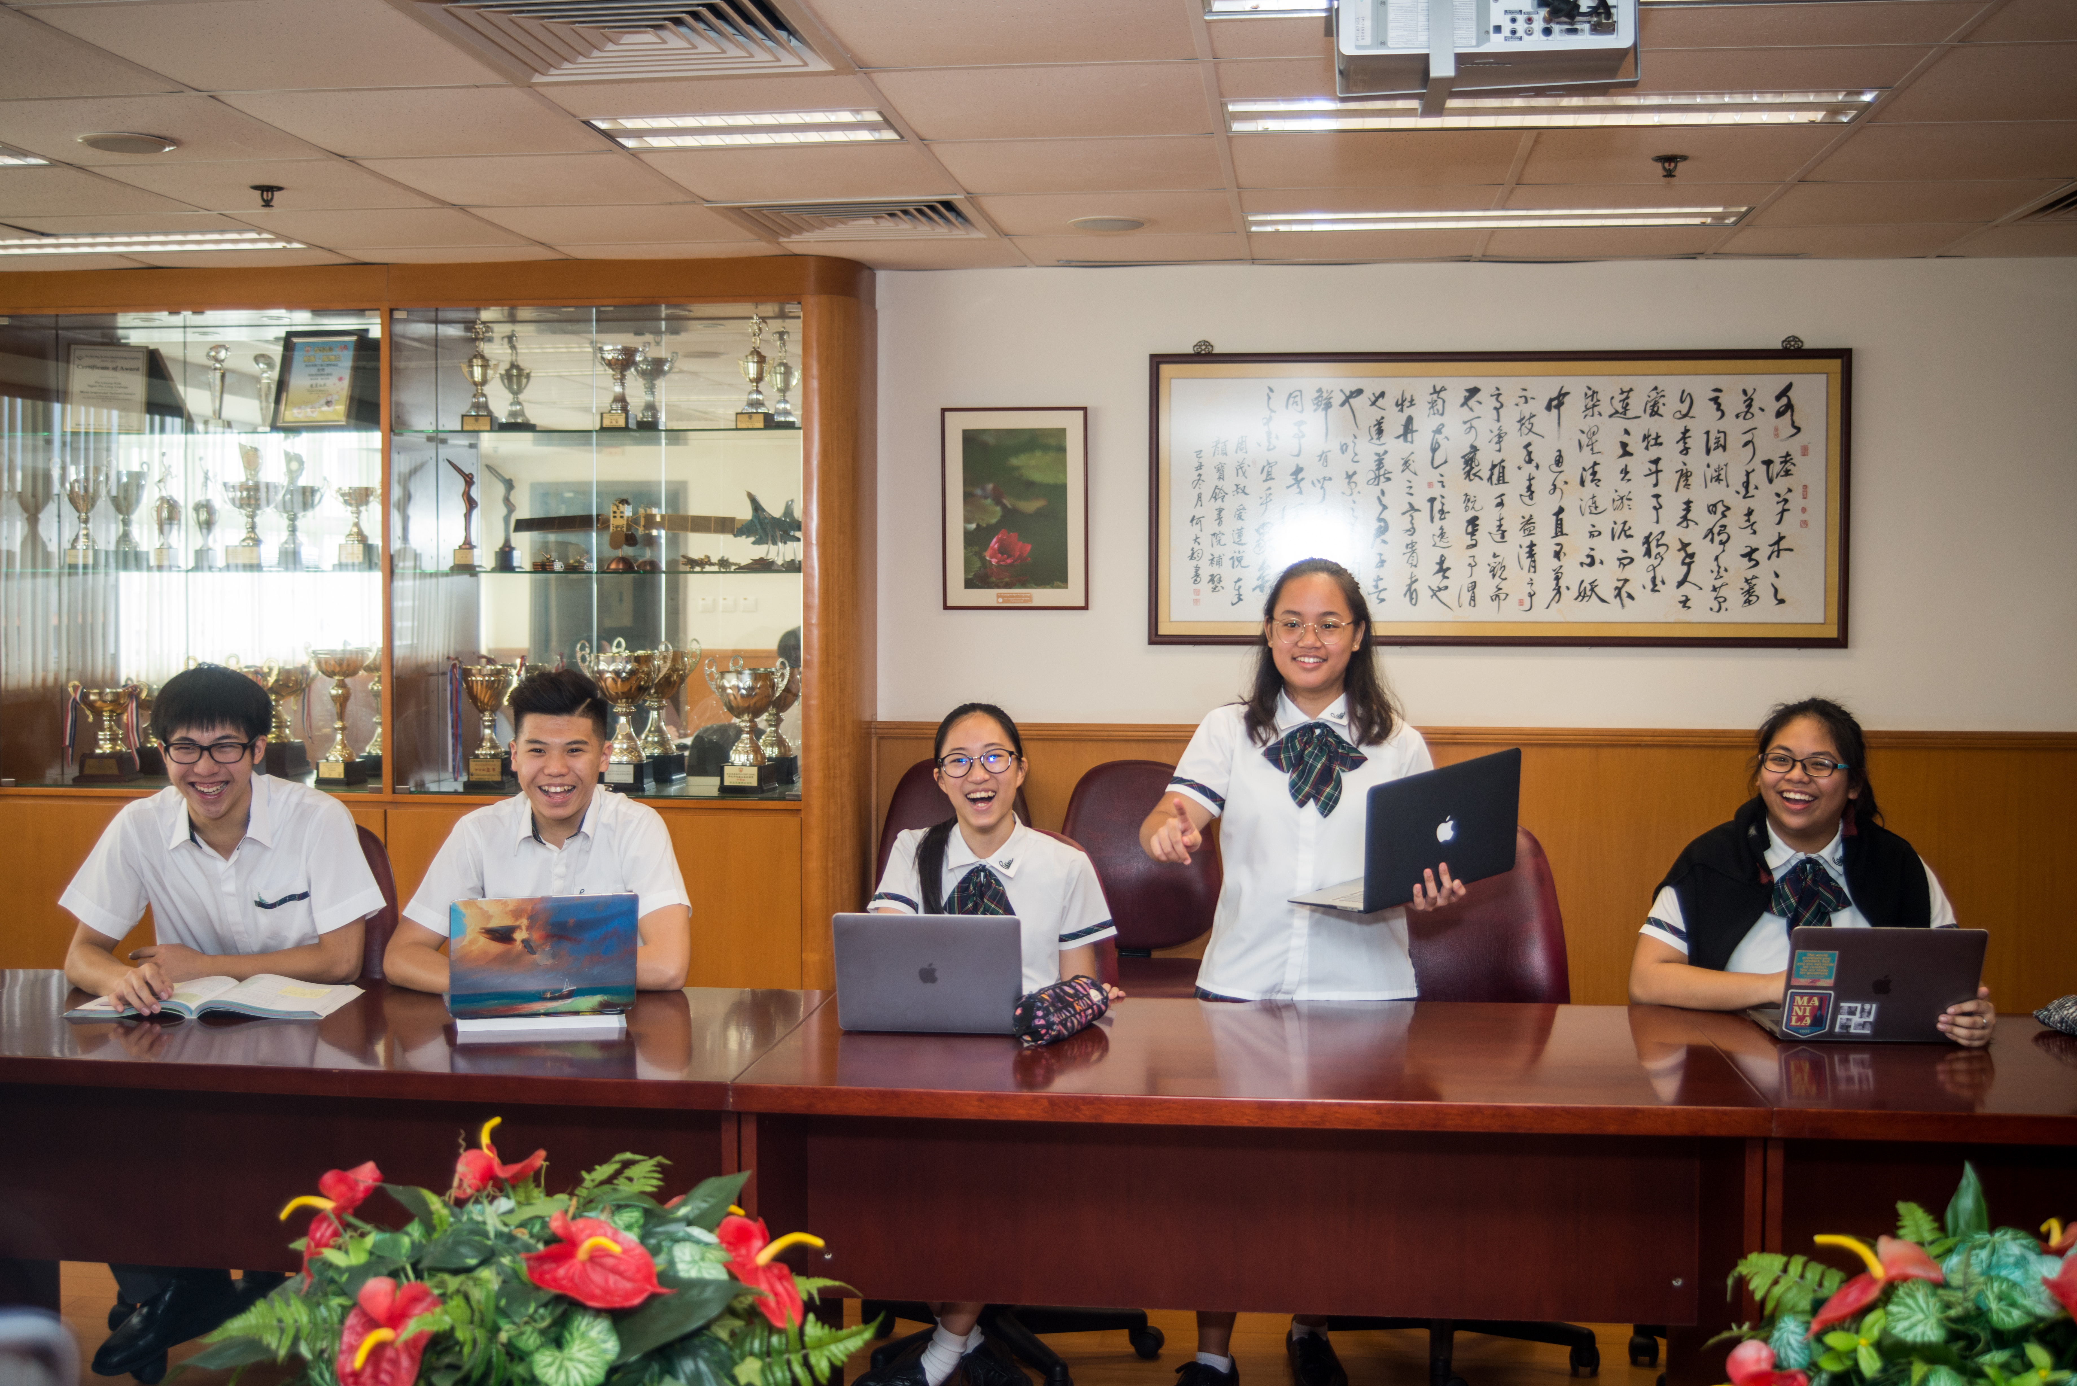
Debating Competition &
International Forum
辯論比賽及國際論壇

Slide 46
Adding Value in
Personal Development
為個人成長增值
Emphasise character formation
重視品格培育
Groom principled and disciplined students
培育有原則及紀律的學生
Nurture leadership qualities
培養領導才能
Individual support service (social worker specially assigned to IB)
個人支援服務 (專門負責IB學生的社工)

Slide 47
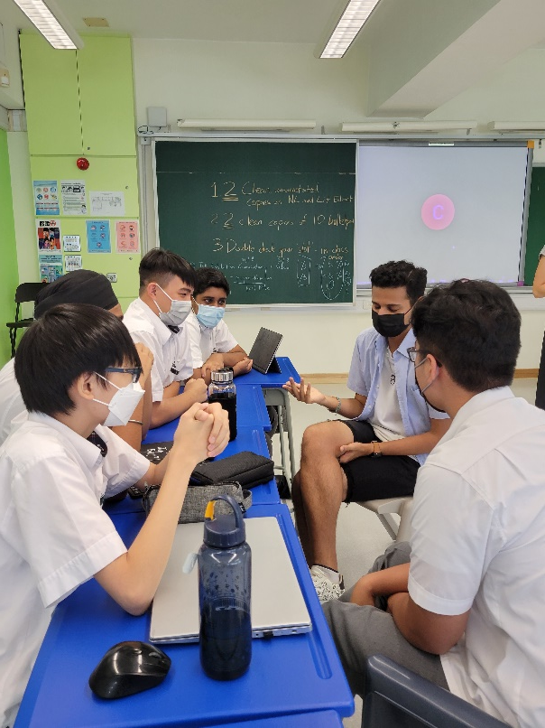
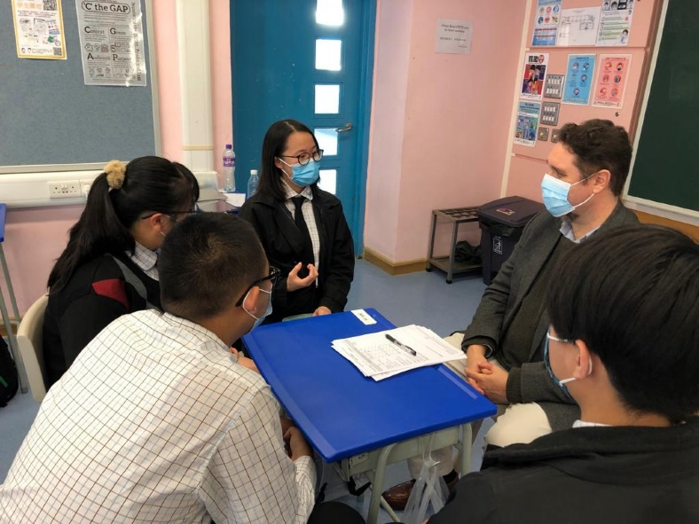
Adding Value in
Personal Development
為個人成長增值
Cultivate sense of belonging to the school and society
培養對學校及社會的歸屬感
Interview Workshop
面試工作坊
Alumni sharing
舊生分享

Slide 48
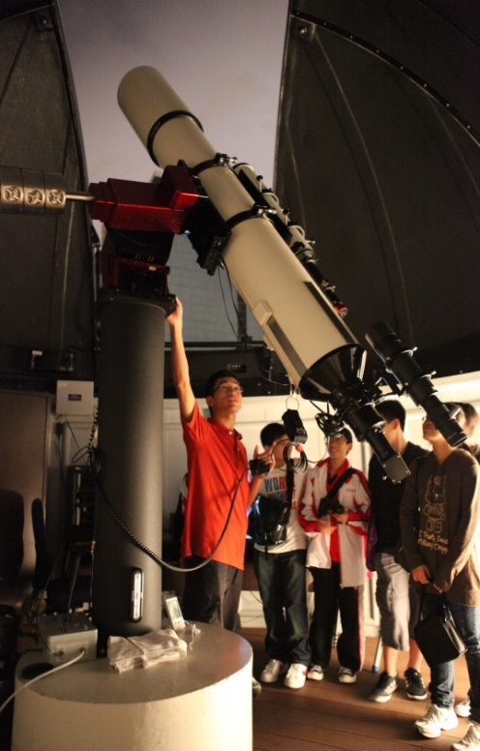
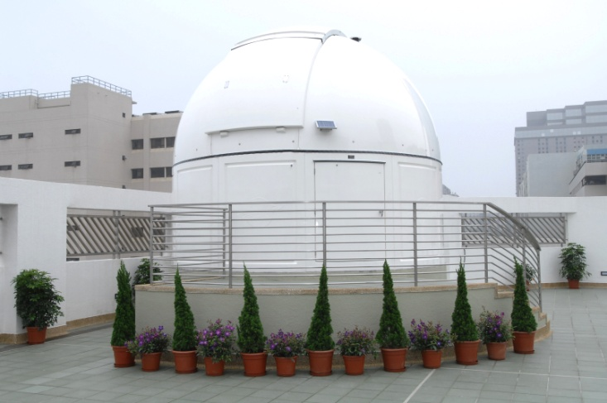

- New Annex 新翼綜合大樓
- Indoor Swimming Pool 室內泳池
- Student Hostel 學生宿舍
- Astronomy & Planetarium Centre 天文及全天候星象館
- Campus TV 校園電視台
- Chinese Medicine Research Centre 中藥研究中心
State-Of-The-Art Facilities
一流設施

Slide 49
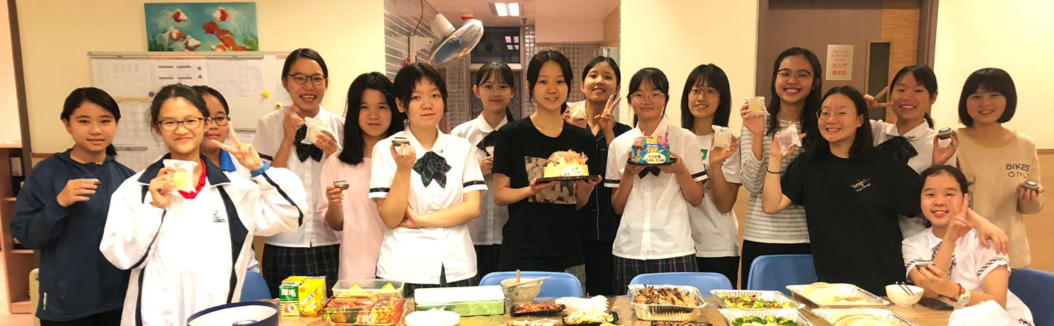
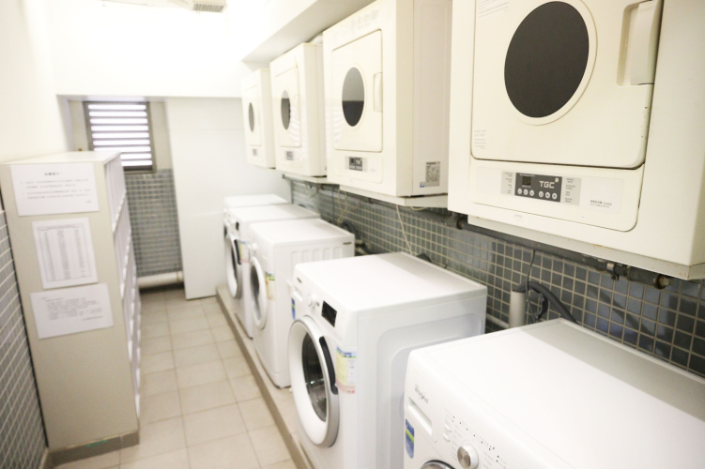
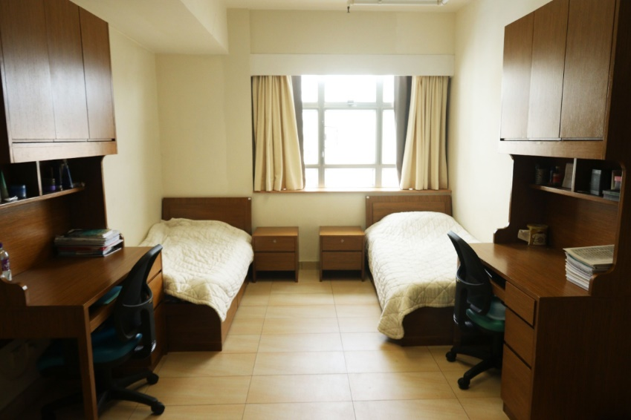

Student Hostel 學生宿舍
Notes:
T: The hostel life and facilities of our school are also worth mentioning here.
With the cozy environment, the student hostel is an ideal place to study and to learn independence. Meals and laundry services are provided. Our hostel wardens take good care of our students. Students are then able to have healthy and disciplined routines. There are also tutors assisting students in homework and revision. Students living in the hostel develop close bonding with each other through various hostel activities such as festive celebrations.

Slide 50
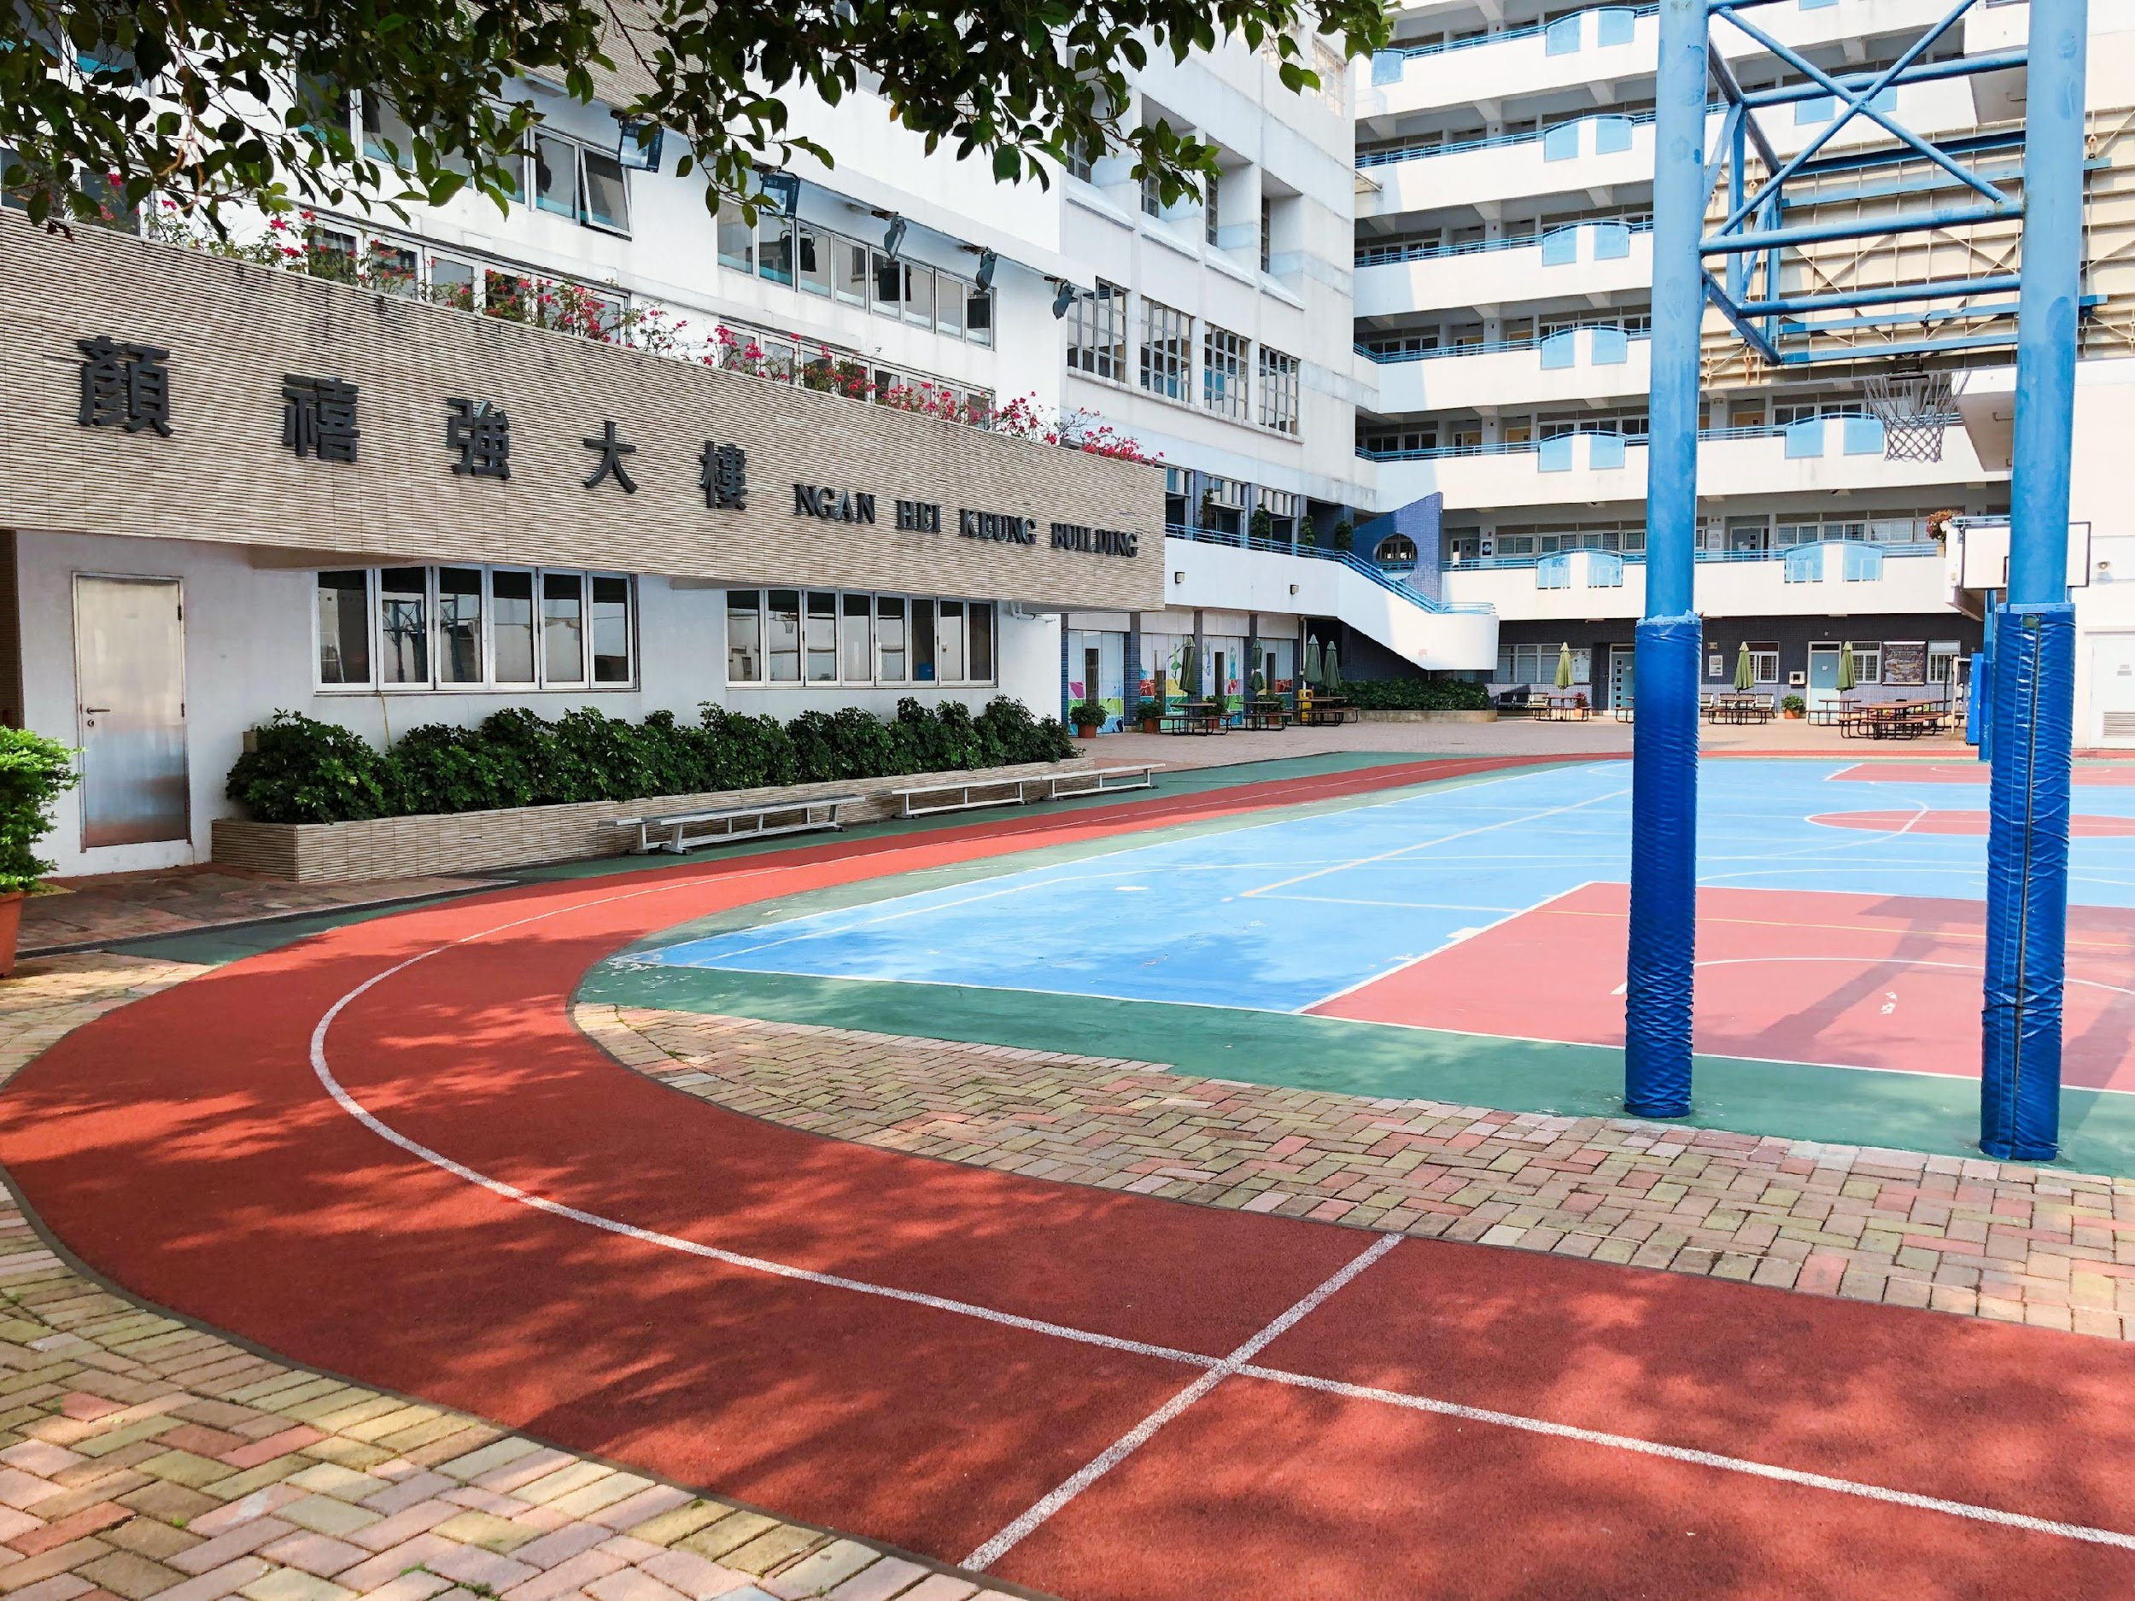
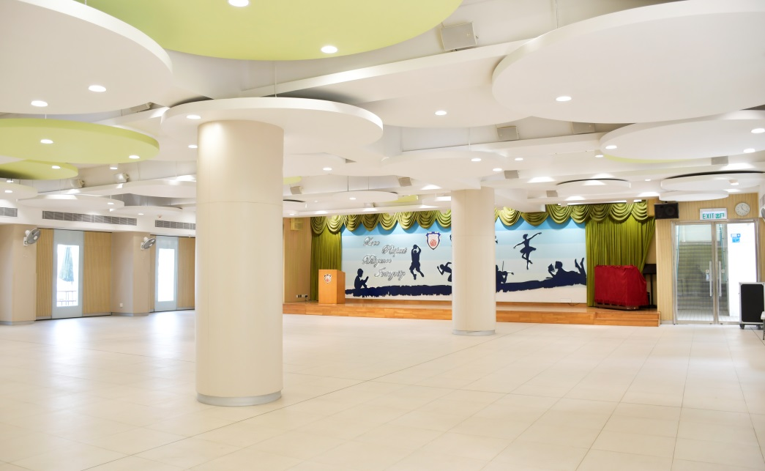
State-Of-The-Art Facilities
一流設施
- Race Track 跑道
- 3 Multi-Function School Halls 三個多用途禮堂

Slide 51
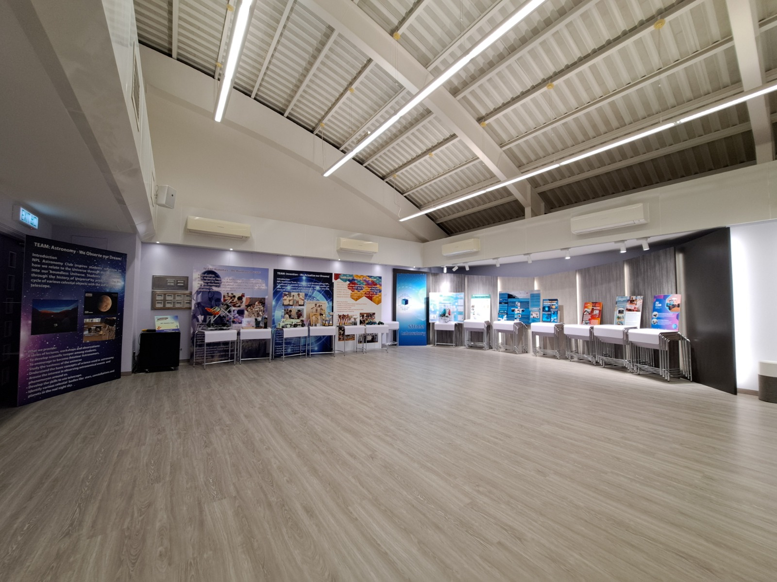
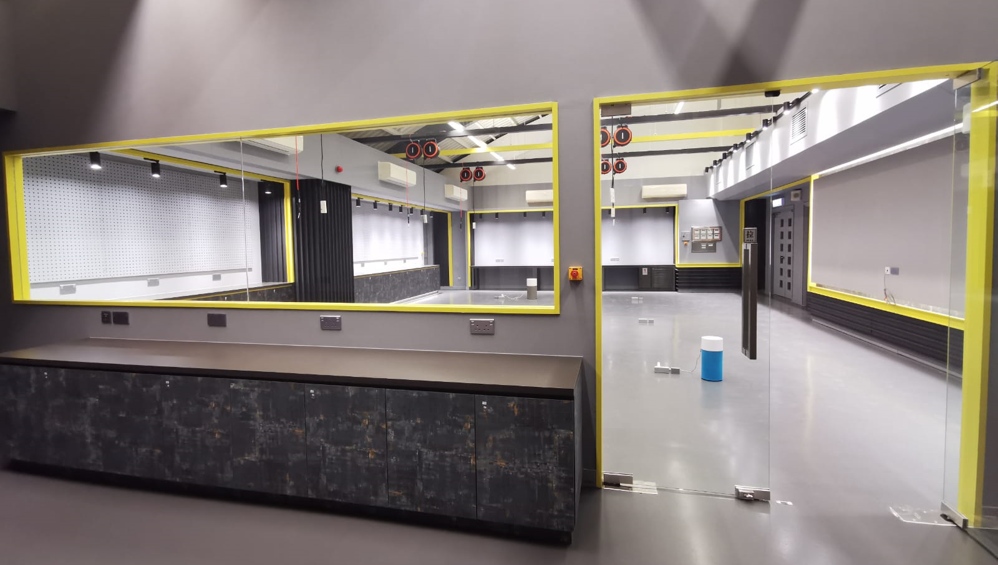
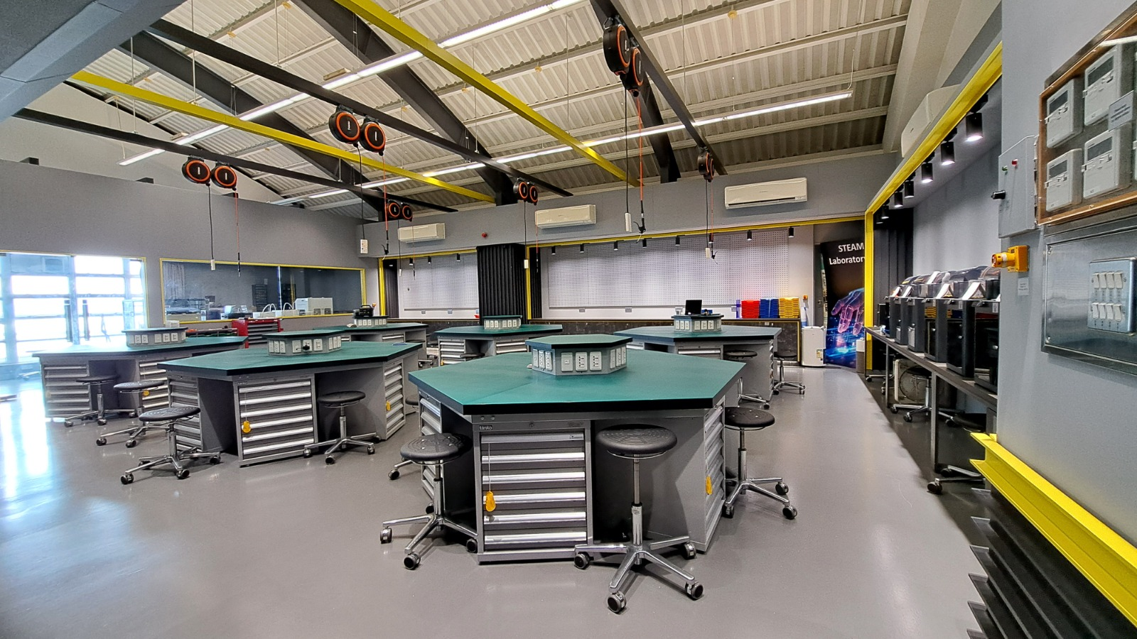
STEAM Lab – Innovation Centre
STEAM 研習室室 – 創新科技中心
Multi-purpose shared space
多用途共享空間
“Garage” workshop
「Garage」 工房

Slide 52
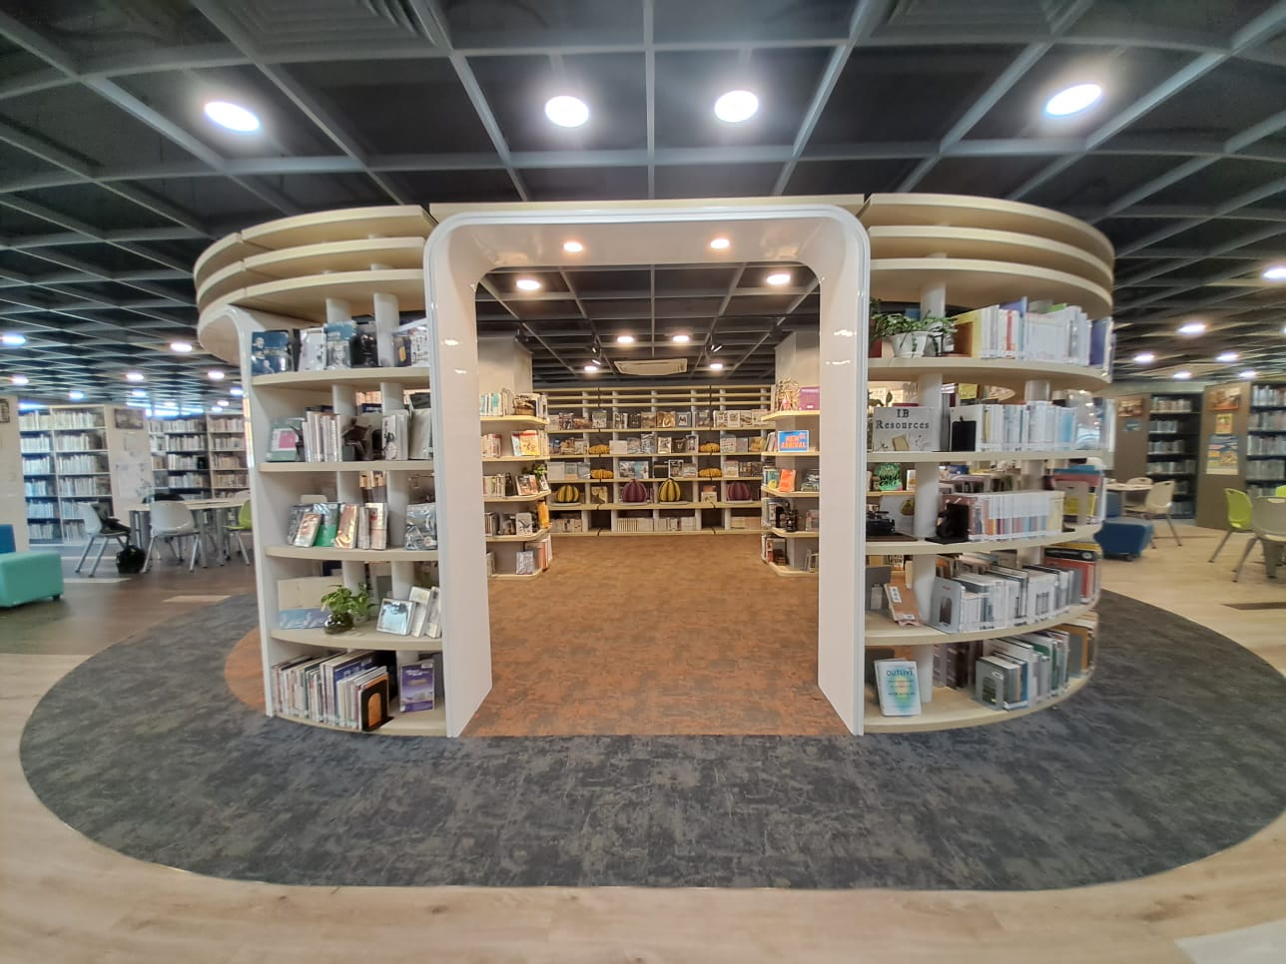
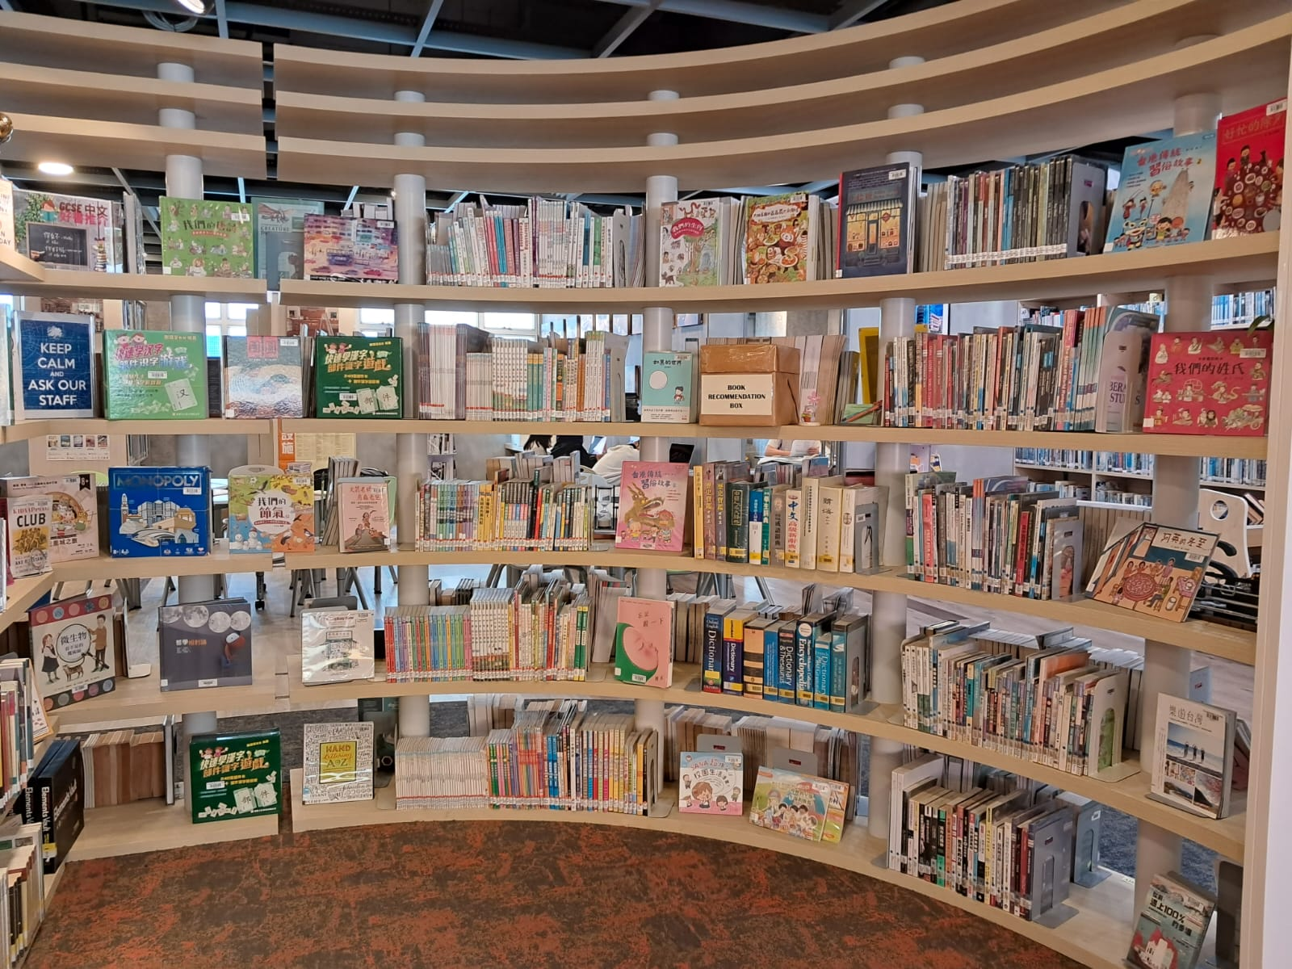
Andrew Ngan Library
顏肇臻圖書館

Slide 53
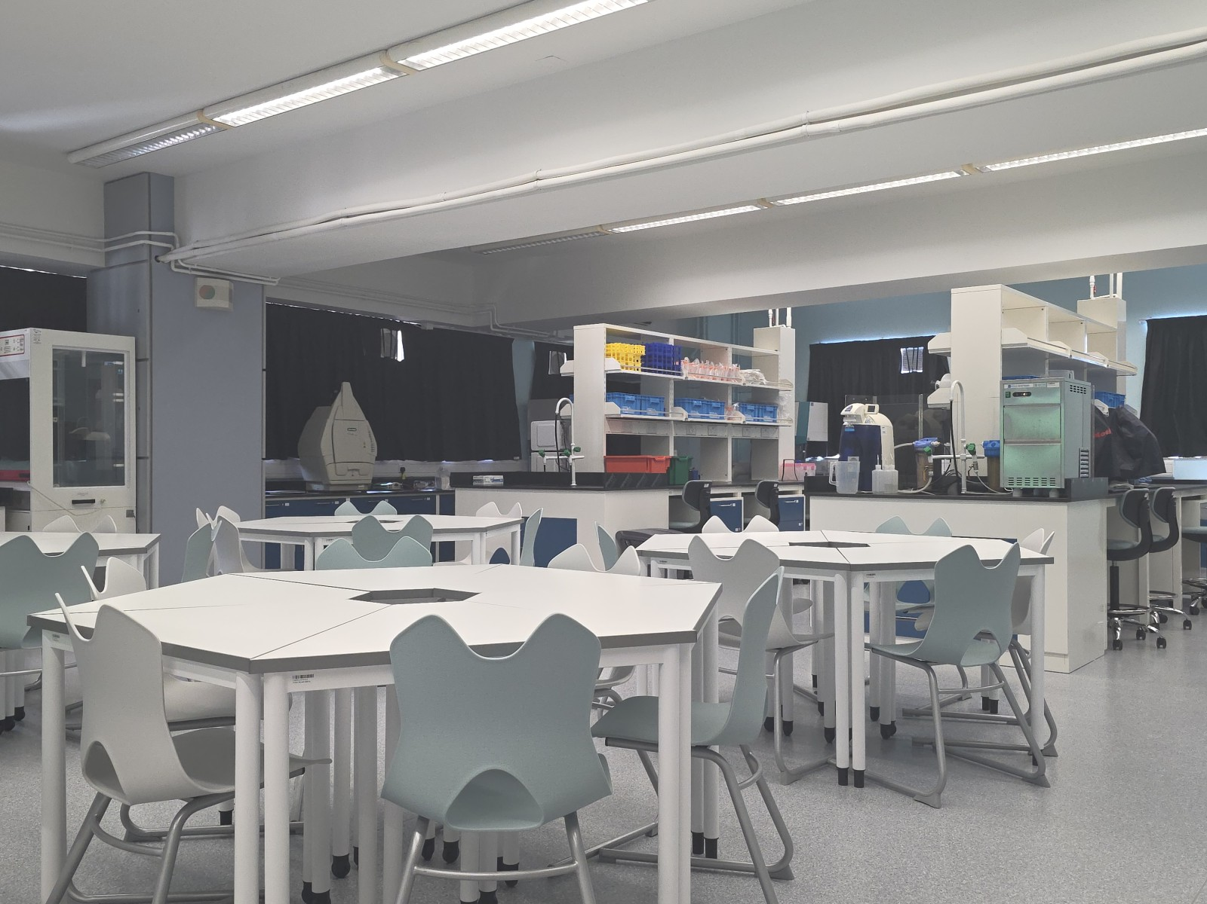
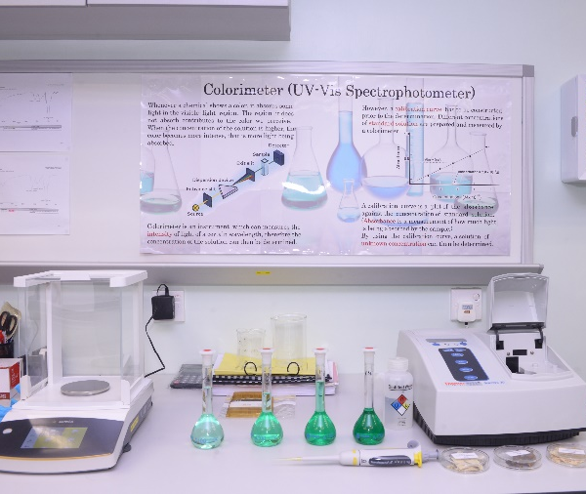
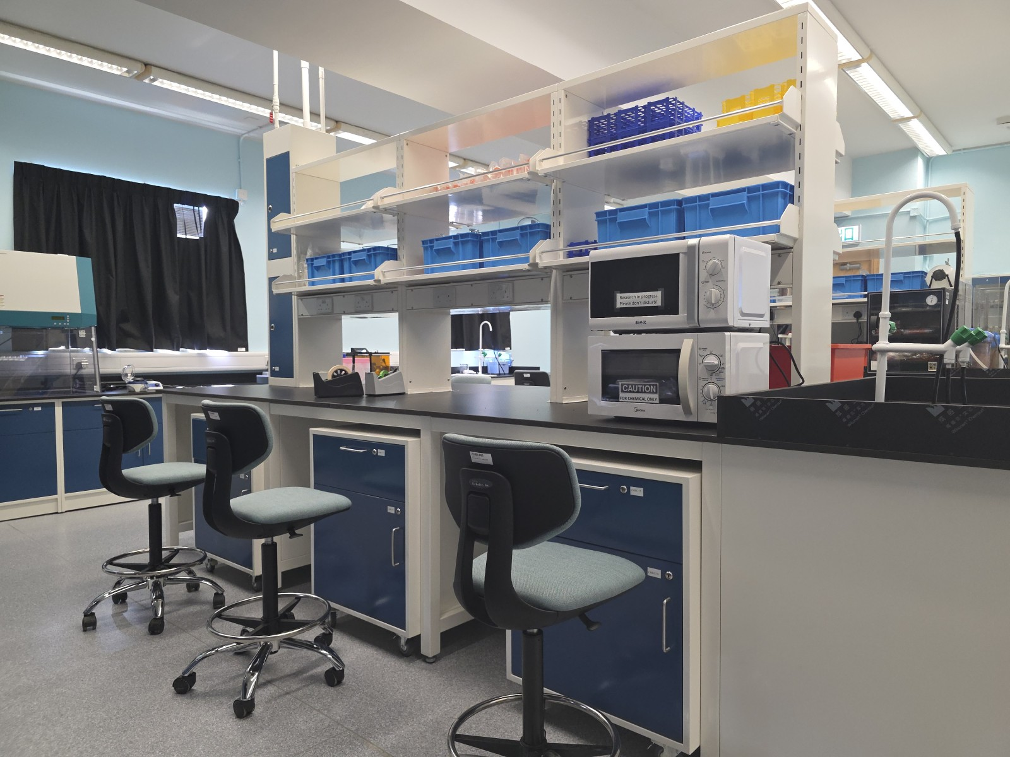
Chinese Medicine Research Centre
中藥研究中心

Slide 54
School Policies
學校政策

Slide 55
NPLC – Assessment Policy
顏寶鈴書院 – 評核政策
F4 & F5 NPL grades
中四及中五校內成績
Term Tests期中測驗(25%)
Exams考試 (75%)
Continuous Assessment
(% is subject-based)
平時分 (各科百分比不一)
First Term Test (Oct)
上學期期中測驗(十月)
First Term Exam (Jan)
上學期考試 (一月)
Second Term Test (Mar)
下學期期中測驗(三月)
Final Exam (June)
期終考試 (六月)
IBDP assessment components + continuous school-based assessment
IBDP評核項目+持續校本評核

Slide 56
IBDP – Assessment Policy
IBDP – 評核政策
IB grades
IB成績
IBDP Internal Assessment & Externally assessed Components (Year 1 & 2)
IBDP校內評核及校外評分項目(中五及中六)
IB Public Exam
(Year 2) (Apr-May)
IB公開考試
(中六) (四月至五月)

Slide 57
Academic Honesty Policy
學術誠信政策
In BYP year, librarian/DP Coordinator/EE Coordinator will deliver information about:
圖書館管理員/DP課程統籌/拓展論文統籌會在銜接課程舉行會向學生介紹以下內容：
  ~ Academic Honesty 學術誠信
  ~ Plagiarism 抄襲
  ~ Intellectual property rights 知識產權
  ~ Use of AI tools AI工具的應用
  ~ turnitin.com
turnitin.com will be used to check students’ work to avoid plagiarism.
會利用turnitin.com檢查學生習作，以免抄襲

Slide 58
IT Policy
IT政策
All IB students are allowed to bring their own devices to enhance learning following the regulations of the school.
所有IB學生可按學校規則攜帶個人電子設備輔助學習

Slide 59
Promotion Policy
升班政策
~ Total score is 24 or above
總分達24分或以上
~ Get a pass in TOK, EE and CAS
TOK, EE及CAS合格
~ No grade 1 or 2 in any subjects
所有科目至少有3分
~ Overall there are no more than 2 subjects with grade 3
不可有超過兩科取得3分
~ Achieve a total of 12 points or more on HL subjects
所有HL科目合共取得至少12分
~ Achieve a total of 9 points or more on SL subjects
所有SL科目合共取得至少9分
~ The exam committee has not judged the candidate to be guilty of academic
dishonesty
評核未有違反學術誠信
~ Has not been absent for more than 30 days
不超過30天缺席
~ Satisfactory conduct
操行良好

Slide 60
Fee Structure in 2026/27
2026/27學費
IB Bridging Year Programme
IB銜接課程
HK$35,900 per annum
每年HK$35,900
(same as DSE stream)
(與DSE課程相同)
Pending for EDB’s approval 待教育局審批

Slide 61
Fee Structure in 2026/27
2026/27學費
Year 1 HK$98,400 per annum
中五 每年HK$98,400
Year 2 HK$98,400 per annum
中六 每年HK$98,400
Pending for EDB’s approval 待教育局審批

Slide 62
Scholarship
獎學金
 | IB Year 1 中五 | IB Year 2 中六
1st in class / form 全班/全級第一 | 50% | 50%
2nd in class / form 全班/全級第二 | 25% | 25%
3rd in class / form 全班/全級第三 | 25% | 25%

Slide 63
Scholarship for IB Exam
IB考試獎學金
Score | Scholarship
45 | $15000
44 | $10000
42-43 | $7000
40-41 | $5000
38-39 | $3000

Slide 64
Fee Remission Scheme
學費減免計劃
Fee Remissions are available
可申請學費減免
Details can be found in our mainstream school webpage
詳請可參閱學校網頁https://www.npl.edu.hk/en/site/view?name=2526+Scheme

Slide 65
Minimum Requirement for Admission
入學最低要求
For F1 overall, F2 overall and F3 First term result:
中一、中二總成績及中三上學期及下學期測驗成績：
An overall 50% average in all subjects
所有科目平均分達50%
50% or above in all the subjects to be chosen in the IBDP
所有將於IBDP選修的科目分數均達50%
60% or above in English
英文分數達60%

Slide 66
Important Dates
重要日期
Application Submission Period : 28 March – 27April 2026
申請期限 : 2026年3月28日- 4月27日
Application Methods申請方法 :
Internal applicants: submit application form via eClass
email
本校生可透過eClass電郵遞交申請表
External applicants: submit applications via HKT platform
外校生可透過HKT平台申請

Slide 67
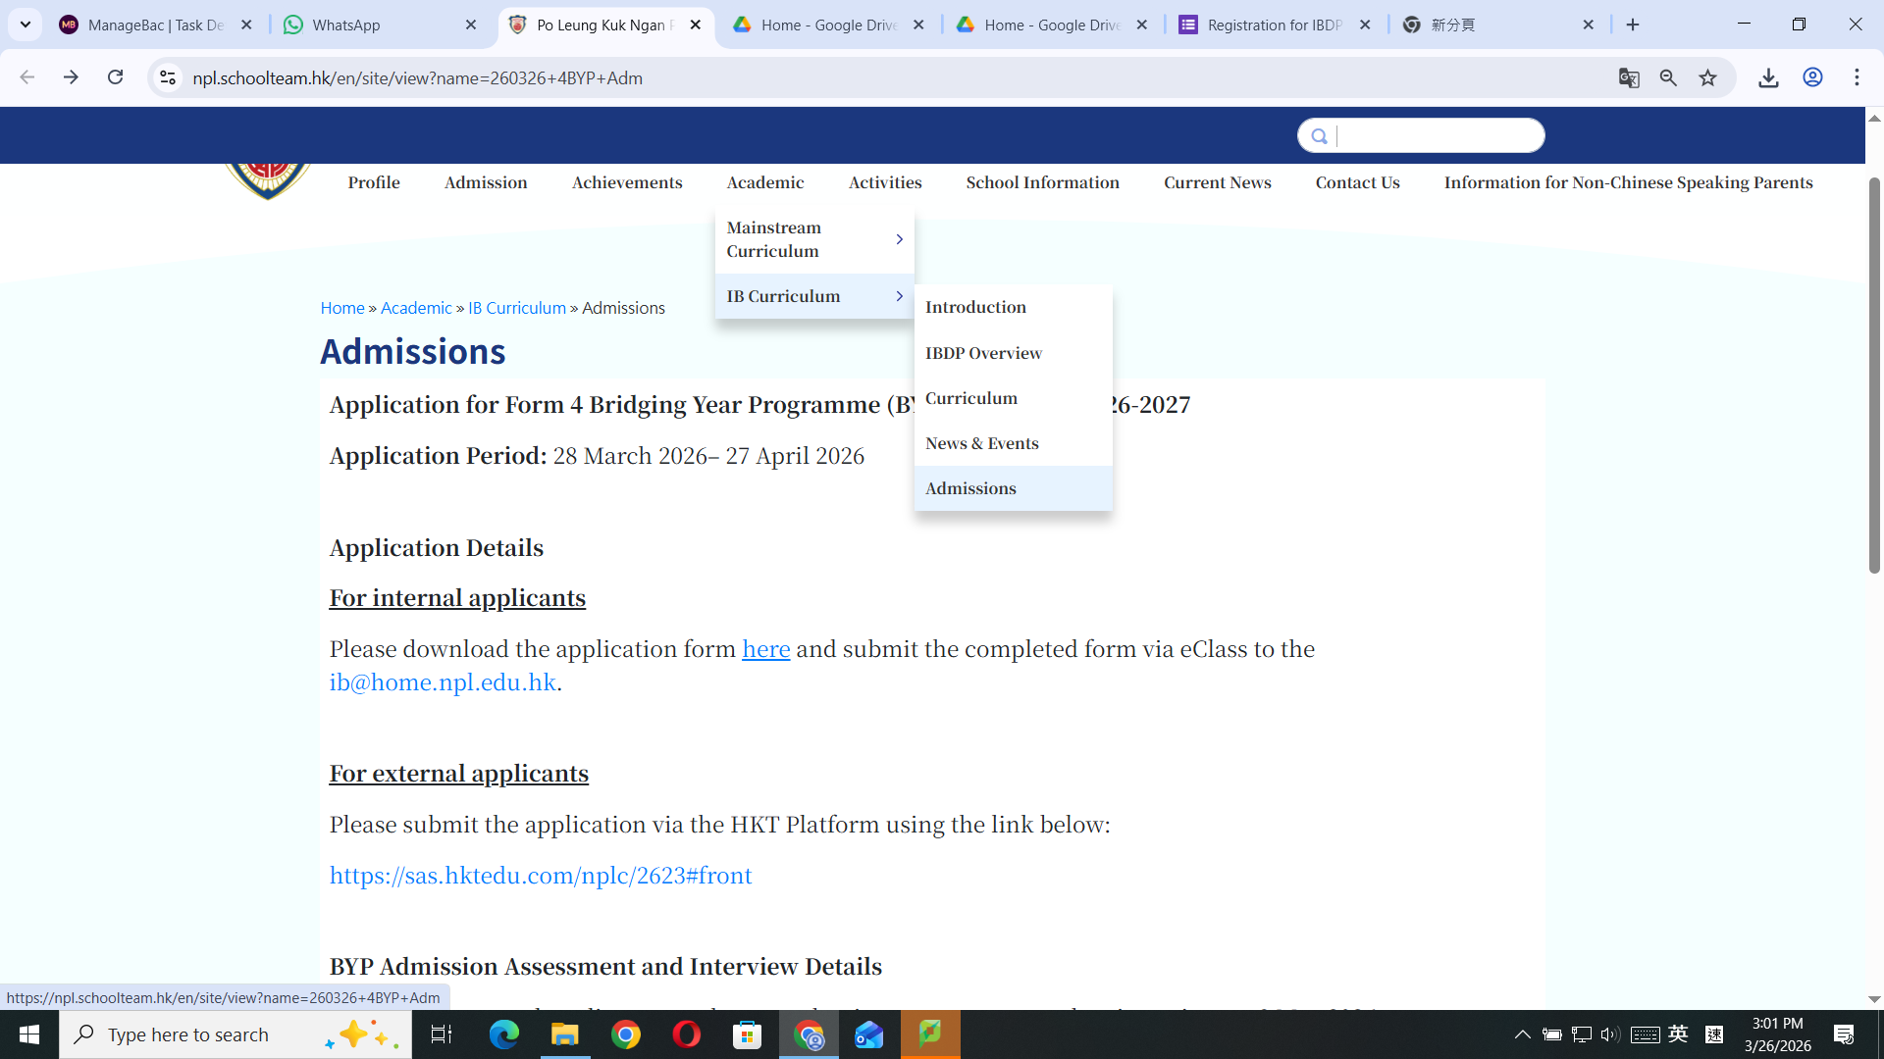
Important Dates
重要日期

Slide 68
Important Dates
重要日期
Internal Applicants 本校學生申請 :
No written assessment, interview only
5 May 2026 – 9 May 2026
無筆試，只有面試
2026年5月5日至2026年5月9日

Slide 69
Important Dates
重要日期
External Applicants 外校生申請 :
Shortlisted candidates will be invited to attend a written assessment and interview on 9 May 2026.
經篩選的申請人需於2026年5月9日進行筆試及面試

Slide 70
Important Dates
重要日期
Result release on 25 May 2026 (Via Email)
結果將於2026年5月25日公佈 (電郵通知)
Registration before 15 June 2026
請於2026年6月15日前註冊

Slide 71
Criteria for offering a subject
科目開設條件
Minimum requirement for offering a particular subject = 5 students.
科目最少有5人選修才會開設

Slide 72
Reminder for NPL students
溫馨提示
Registration in IB school =
giving up your DSE stream place
註冊IB學位 = 放棄DSE學位

Slide 73
Q & A Session
答問環節

Slide 74


Parent Survey
家長問卷

